Slide 1
Skinker DeBaliviere, DeBaliviere Place, West End, Visitation Park
Monthly Crime Report: April 2020
Washington University Medical Center

Slide 2
Skinker DeBaliviere: Summary Notes
9 total crimes in April 2020
-57% change compared to April 2019 (21 total crimes)
0 crime(s) against persons in April 2020
-100% change compared to April 2019 (2 crimes against persons)
38 total crimes in 2020
-49% change compared to this time in 2019 (75 total crimes)
2 crime(s) against persons in 2020
-82% change compared to this time in 2019 (11 crimes against persons)

Slide 3
Skinker DeBaliviere: Year to Year Comparison
Part 1 Crimes | Jan | Feb | Mar | Apr | May | Jun | Jul | Aug | Sep | Oct | Nov | Dec | Total
Aggravated Assault | 0 | 0 | 7 | 0 | 6 | 1 | 0 | 1 | 0 | 0 | 2 | 1 | 18
Arson | 0 | 0 | 0 | 0 | 0 | 0 | 0 | 0 | 0 | 0 | 0 | 0 | 0
Burgalry | 4 | 9 | 0 | 1 | 4 | 6 | 5 | 2 | 4 | 2 | 1 | 1 | 39
Homicide | 0 | 0 | 0 | 0 | 0 | 0 | 0 | 0 | 0 | 0 | 0 | 1 | 1
Larceny | 4 | 8 | 16 | 18 | 15 | 17 | 21 | 9 | 11 | 20 | 13 | 10 | 162
Motor Vehicle Theft | 1 | 3 | 0 | 0 | 2 | 1 | 1 | 4 | 1 | 2 | 4 | 1 | 20
Robbery | 1 | 1 | 0 | 2 | 4 | 5 | 1 | 2 | 4 | 1 | 3 | 0 | 24
Total | 10 | 21 | 23 | 21 | 31 | 30 | 28 | 18 | 20 | 25 | 23 | 14 | 264
Part 1 Crimes | Jan | Feb | Mar | Apr | Total
Aggravated Assault | 0 | 0 | 0 | 0 | 0
Arson | 0 | 0 | 0 | 0 | 0
Burgalry | 3 | 0 | 0 | 1 | 4
Homicide | 0 | 0 | 0 | 0 | 0
Larceny | 7 | 7 | 5 | 5 | 24
Motor Vehicle Theft | 2 | 1 | 2 | 3 | 8
Robbery | 1 | 1 | 0 | 0 | 2
Total | 13 | 9 | 7 | 9 | 38

Slide 4
Skinker DeBaliviere: Summary Tables
Day of the Week | Number of Crimes
Sun | 4
Mon | 1
Tue | 0
Wed | 1
Thu | 0
Fri | 0
Sat | 3
Total | 9
Part 1 Crimes | Number of Crimes
Burgalry | 1
Larceny | 5
Motor Vehicle Theft | 3
Total | 9
Crimes Against Persons | Number of Crimes
FALSE | 9
Total | 9
Time of Day | Number of Crimes
Day | 8
Night | 1
Total | 9

Slide 5
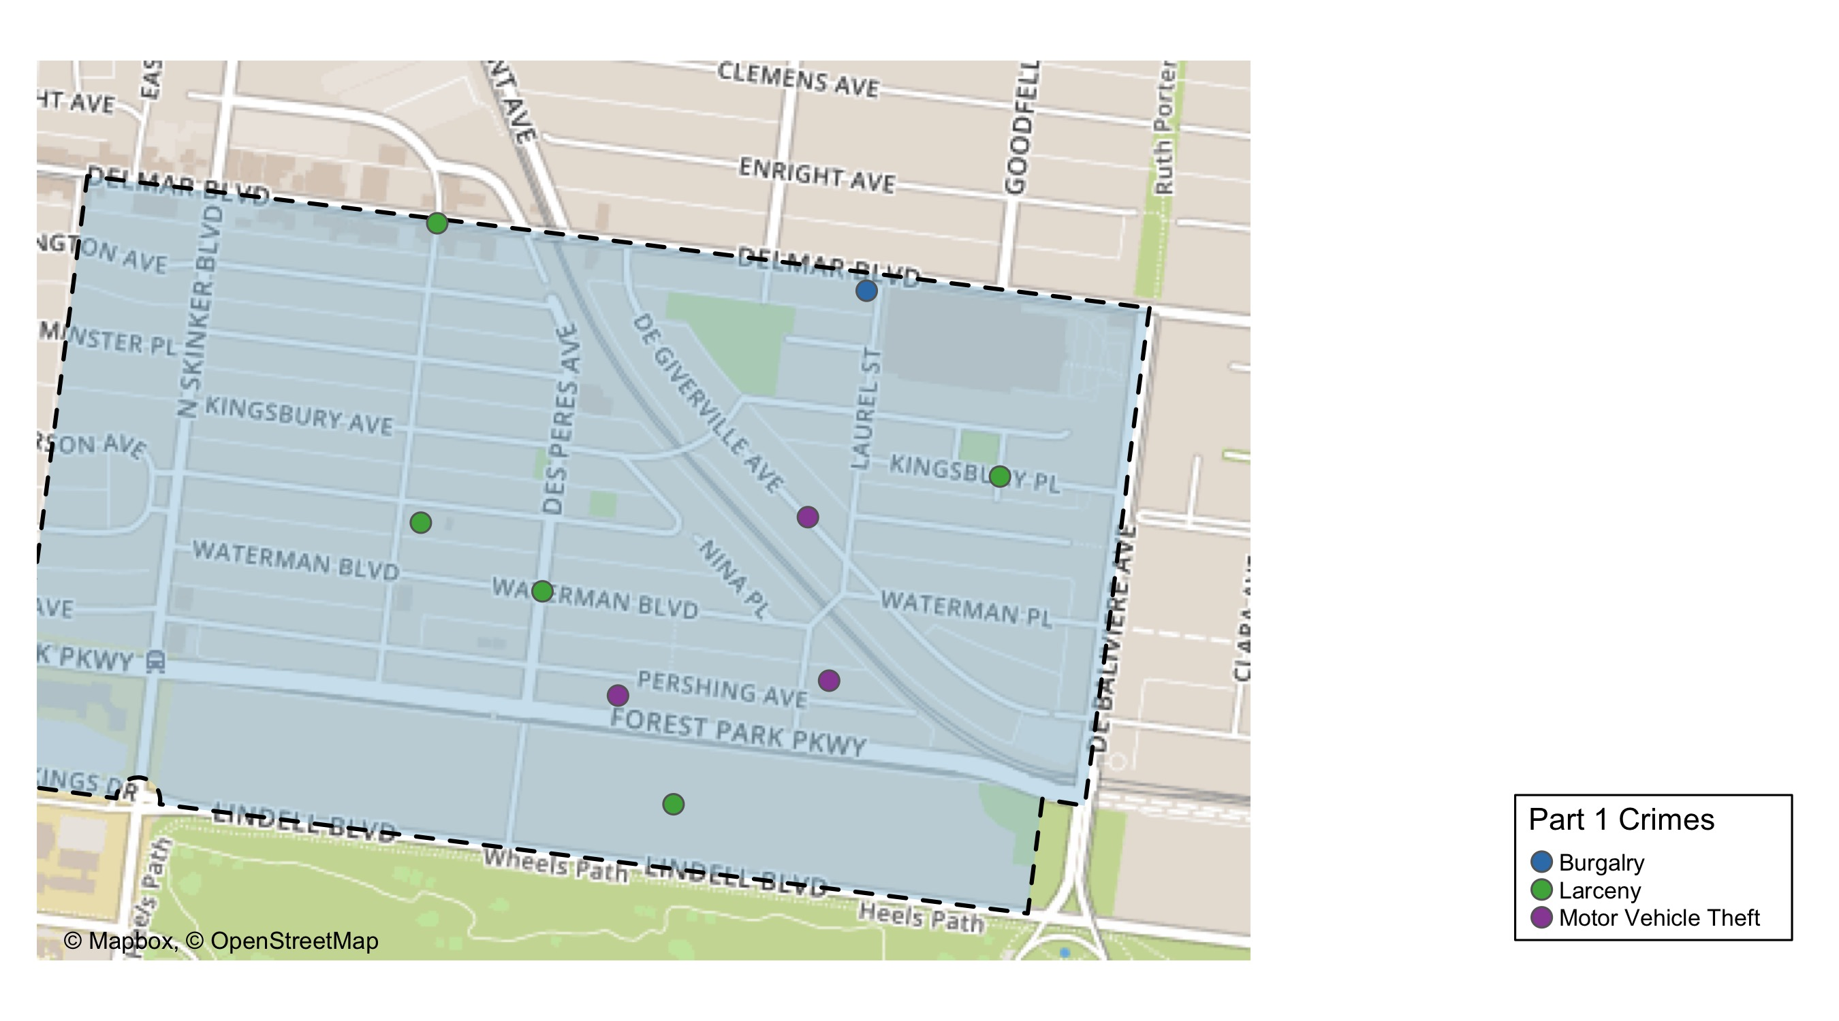
Skinker DeBaliviere: Total Crime Map

Slide 6
DeBaliviere Place: Summary Notes
9 total crimes in April 2020
12% change compared to April 2019 (8 total crimes)
0 crime(s) against persons in April 2020
-100% change compared to April 2019 (1 crimes against persons)
50 total crimes in 2020
56% change compared to this time in 2019 (32 total crimes)
14 crime(s) against persons in 2020
180% change compared to this time in 2019 (5 crimes against persons)

Slide 7
DeBaliviere Place: Year to Year Comparison
Part 1 Crimes | Jan | Feb | Mar | Apr | May | Jun | Jul | Aug | Sep | Oct | Nov | Dec | Total
Aggravated Assault | 0 | 0 | 0 | 0 | 0 | 2 | 3 | 0 | 5 | 1 | 1 | 1 | 13
Arson | 0 | 0 | 0 | 0 | 0 | 0 | 0 | 0 | 0 | 0 | 0 | 0 | 0
Burgalry | 1 | 0 | 1 | 1 | 2 | 0 | 0 | 2 | 2 | 3 | 0 | 0 | 12
Homicide | 0 | 0 | 0 | 0 | 0 | 0 | 0 | 0 | 0 | 0 | 0 | 0 | 0
Larceny | 8 | 8 | 0 | 4 | 2 | 6 | 10 | 8 | 21 | 8 | 18 | 13 | 106
Motor Vehicle Theft | 0 | 1 | 1 | 2 | 0 | 2 | 3 | 1 | 4 | 7 | 3 | 0 | 24
Robbery | 2 | 2 | 0 | 1 | 0 | 0 | 3 | 0 | 1 | 0 | 1 | 0 | 10
Total | 11 | 11 | 2 | 8 | 4 | 10 | 19 | 11 | 33 | 19 | 23 | 14 | 165
Part 1 Crimes | Jan | Feb | Mar | Apr | Total
Aggravated Assault | 4 | 4 | 1 | 0 | 9
Arson | 0 | 0 | 0 | 0 | 0
Burgalry | 0 | 0 | 0 | 0 | 0
Homicide | 0 | 0 | 0 | 0 | 0
Larceny | 5 | 7 | 14 | 6 | 32
Motor Vehicle Theft | 0 | 1 | 0 | 3 | 4
Robbery | 3 | 2 | 0 | 0 | 5
Total | 12 | 14 | 15 | 9 | 50

Slide 8
DeBaliviere Place: Summary Tables
Day of the Week | Number of Crimes
Sun | 1
Mon | 1
Tue | 3
Wed | 0
Thu | 2
Fri | 1
Sat | 1
Total | 9
Part 1 Crimes | Number of Crimes
Larceny | 6
Motor Vehicle Theft | 3
Total | 9
Crimes Against Persons | Number of Crimes
FALSE | 9
Total | 9
Time of Day | Number of Crimes
Day | 9
Total | 9

Slide 9
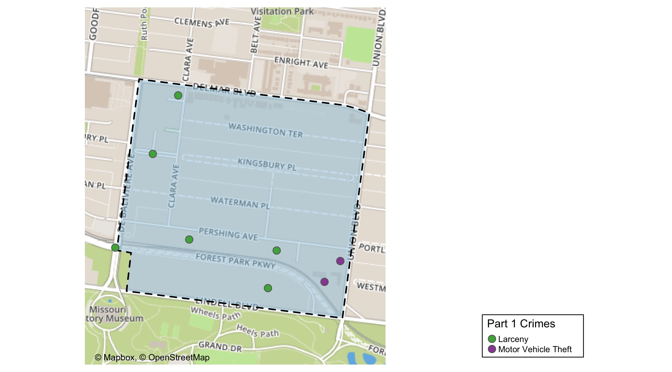
DeBaliviere Place: Total Crime Map

Slide 10
West End: Summary Notes
35 total crimes in April 2020
-19% change compared to April 2019 (43 total crimes)
15 crime(s) against persons in April 2020
7% change compared to April 2019 (14 crimes against persons)
119 total crimes in 2020
-11% change compared to this time in 2019 (133 total crimes)
40 crime(s) against persons in 2020
-11% change compared to this time in 2019 (45 crimes against persons)

Slide 11
West End: Year to Year Comparison
Part 1 Crimes | Jan | Feb | Mar | Apr | May | Jun | Jul | Aug | Sep | Oct | Nov | Dec | Total
Aggravated Assault | 6 | 4 | 6 | 13 | 11 | 6 | 9 | 12 | 13 | 11 | 3 | 6 | 100
Arson | 0 | 0 | 0 | 0 | 0 | 0 | 1 | 0 | 1 | 1 | 0 | 0 | 3
Burgalry | 4 | 4 | 5 | 7 | 5 | 4 | 1 | 6 | 6 | 0 | 0 | 4 | 46
Homicide | 0 | 0 | 0 | 0 | 0 | 0 | 1 | 0 | 1 | 0 | 0 | 1 | 3
Larceny | 7 | 13 | 11 | 19 | 12 | 19 | 20 | 22 | 21 | 15 | 17 | 7 | 183
Motor Vehicle Theft | 5 | 5 | 5 | 3 | 2 | 1 | 6 | 5 | 8 | 6 | 3 | 7 | 56
Robbery | 6 | 4 | 5 | 1 | 2 | 5 | 3 | 4 | 3 | 6 | 4 | 7 | 50
Total | 28 | 30 | 32 | 43 | 32 | 35 | 41 | 49 | 53 | 39 | 27 | 32 | 441
Part 1 Crimes | Jan | Feb | Mar | Apr | Total
Aggravated Assault | 10 | 1 | 10 | 14 | 35
Arson | 0 | 0 | 0 | 1 | 1
Burgalry | 4 | 3 | 5 | 4 | 16
Homicide | 1 | 1 | 0 | 1 | 3
Larceny | 15 | 13 | 8 | 9 | 45
Motor Vehicle Theft | 3 | 3 | 3 | 5 | 14
Robbery | 2 | 2 | 0 | 1 | 5
Total | 35 | 23 | 26 | 35 | 119

Slide 12
West End: Summary Tables
Day of the Week | Number of Crimes
Sun | 5
Mon | 6
Tue | 5
Wed | 5
Thu | 3
Fri | 6
Sat | 5
Total | 35
Part 1 Crimes | Number of Crimes
Aggravated Assault | 14
Arson | 1
Burgalry | 4
Homicide | 1
Larceny | 9
Motor Vehicle Theft | 5
Robbery | 1
Total | 35
Crimes Against Persons | Number of Crimes
FALSE | 19
TRUE | 16
Total | 35
Time of Day | Number of Crimes
Day | 27
Night | 8
Total | 35

Slide 13
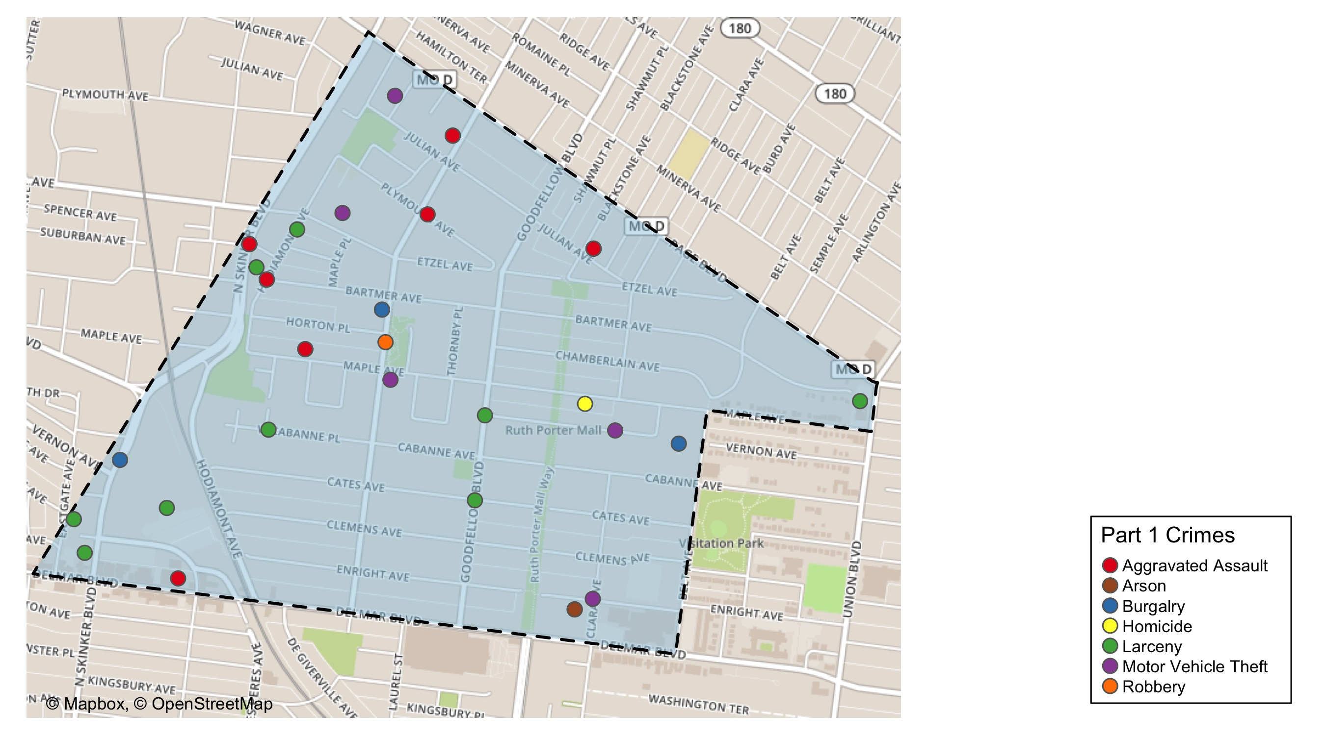
West End: Total Crime Map

Slide 14
Visitation Park: Summary Notes
10 total crimes in April 2020
400% change compared to April 2019 (2 total crimes)
2 crime(s) against persons in April 2020
Inf change compared to April 2019 (0 crimes against persons)
20 total crimes in 2020
18% change compared to this time in 2019 (17 total crimes)
5 crime(s) against persons in 2020
-17% change compared to this time in 2019 (6 crimes against persons)

Slide 15
Visitation Park: Year to Year Comparison
Part 1 Crimes | Jan | Feb | Mar | Apr | May | Jun | Jul | Aug | Sep | Oct | Nov | Dec | Total
Aggravated Assault | 1 | 0 | 3 | 0 | 0 | 0 | 1 | 1 | 4 | 1 | 0 | 1 | 12
Arson | 0 | 0 | 0 | 0 | 0 | 0 | 0 | 0 | 0 | 0 | 0 | 0 | 0
Burgalry | 0 | 1 | 2 | 1 | 2 | 0 | 0 | 0 | 0 | 0 | 1 | 0 | 7
Homicide | 0 | 0 | 0 | 0 | 1 | 0 | 0 | 0 | 0 | 0 | 0 | 0 | 1
Larceny | 2 | 1 | 1 | 0 | 0 | 1 | 2 | 8 | 2 | 7 | 2 | 3 | 29
Motor Vehicle Theft | 1 | 1 | 0 | 1 | 1 | 0 | 0 | 0 | 1 | 0 | 2 | 0 | 7
Robbery | 2 | 0 | 0 | 0 | 0 | 0 | 0 | 0 | 0 | 1 | 0 | 1 | 4
Total | 6 | 3 | 6 | 2 | 4 | 1 | 3 | 9 | 7 | 9 | 5 | 5 | 60
Part 1 Crimes | Jan | Feb | Mar | Apr | Total
Aggravated Assault | 1 | 1 | 1 | 1 | 4
Arson | 0 | 0 | 0 | 0 | 0
Burgalry | 0 | 1 | 1 | 2 | 4
Homicide | 0 | 0 | 0 | 1 | 1
Larceny | 0 | 3 | 1 | 5 | 9
Motor Vehicle Theft | 0 | 0 | 1 | 0 | 1
Robbery | 0 | 0 | 0 | 1 | 1
Total | 1 | 5 | 4 | 10 | 20

Slide 16
Visitation Park: Summary Tables
Day of the Week | Number of Crimes
Sun | 4
Mon | 1
Tue | 0
Wed | 1
Thu | 2
Fri | 2
Sat | 0
Total | 10
Part 1 Crimes | Number of Crimes
Aggravated Assault | 1
Burgalry | 2
Homicide | 1
Larceny | 5
Robbery | 1
Total | 10
Crimes Against Persons | Number of Crimes
FALSE | 7
TRUE | 3
Total | 10
Time of Day | Number of Crimes
Day | 5
Night | 5
Total | 10

Slide 17
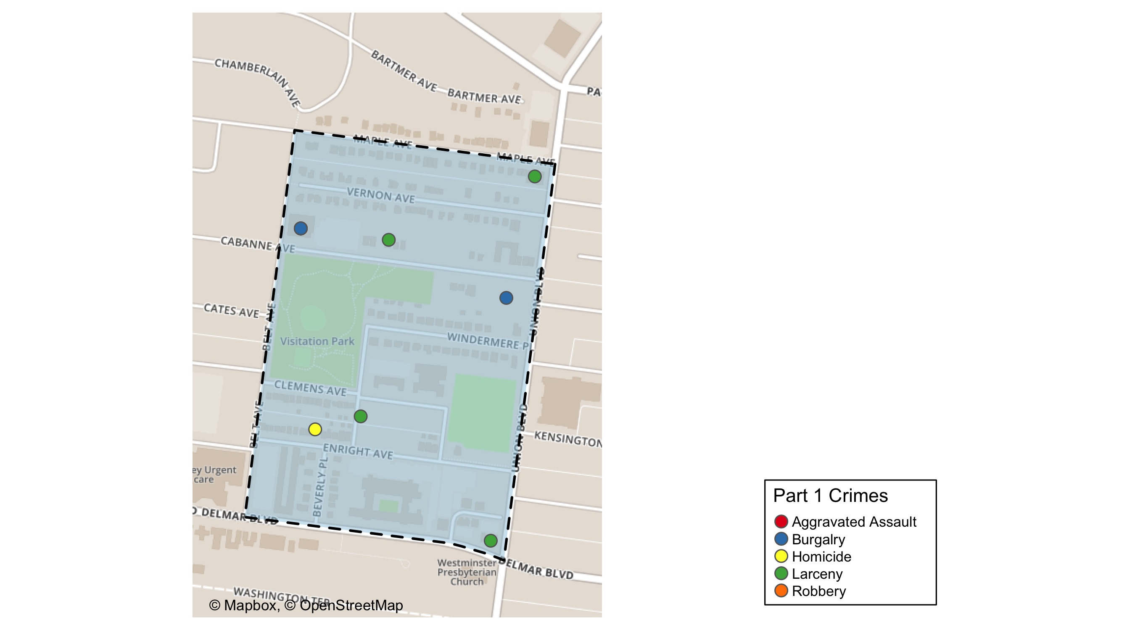
Visitation Park: Total Crime Map

Slide 18
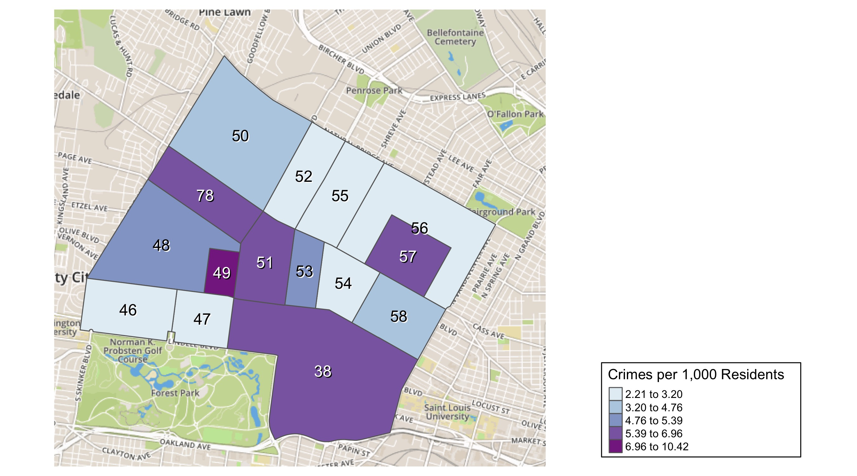
District 5: Crime Rates Map

Slide 19
District 5: Density Map Explanation
There are 15 neighborhoods in District 5
The minimum number of crimes in one neighborhood was 4 (Lewis Place)
The maximum number of crimes in one neighborhood was 90 (Central West End)
The mean number of crimes in one neighborhood was 19
The minimum rate of crimes in one neighborhood was 2.21 (Skinker DeBaliviere)
The maximum rate of crimes in one neighborhood was 10.42 (Visitation Park)
The mean rate of crimes in one neighborhood was 4.79

Slide 20
Skinker DeBaliviere: Neighborhood Detail
Appendix 1

Slide 21
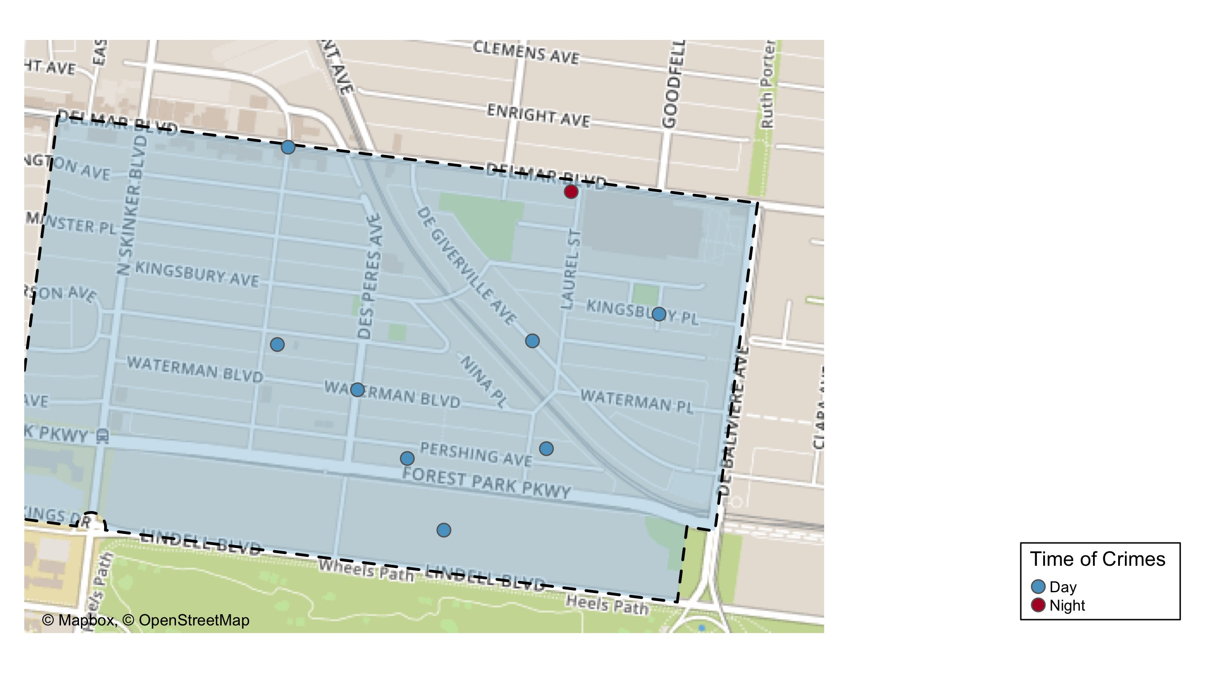
Skinker DeBaliviere: Time of Crimes Map

Slide 22
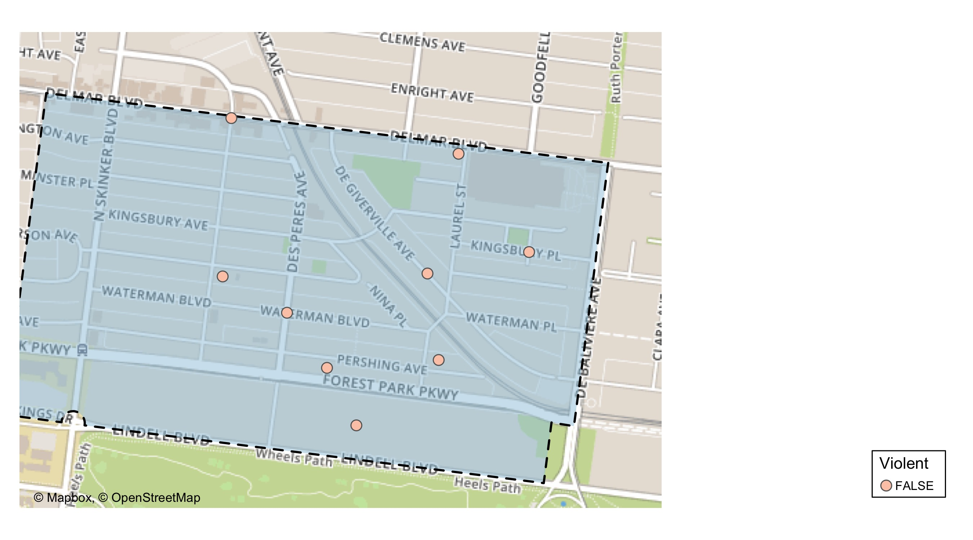
Skinker DeBaliviere: Violent Crime Map

Slide 23
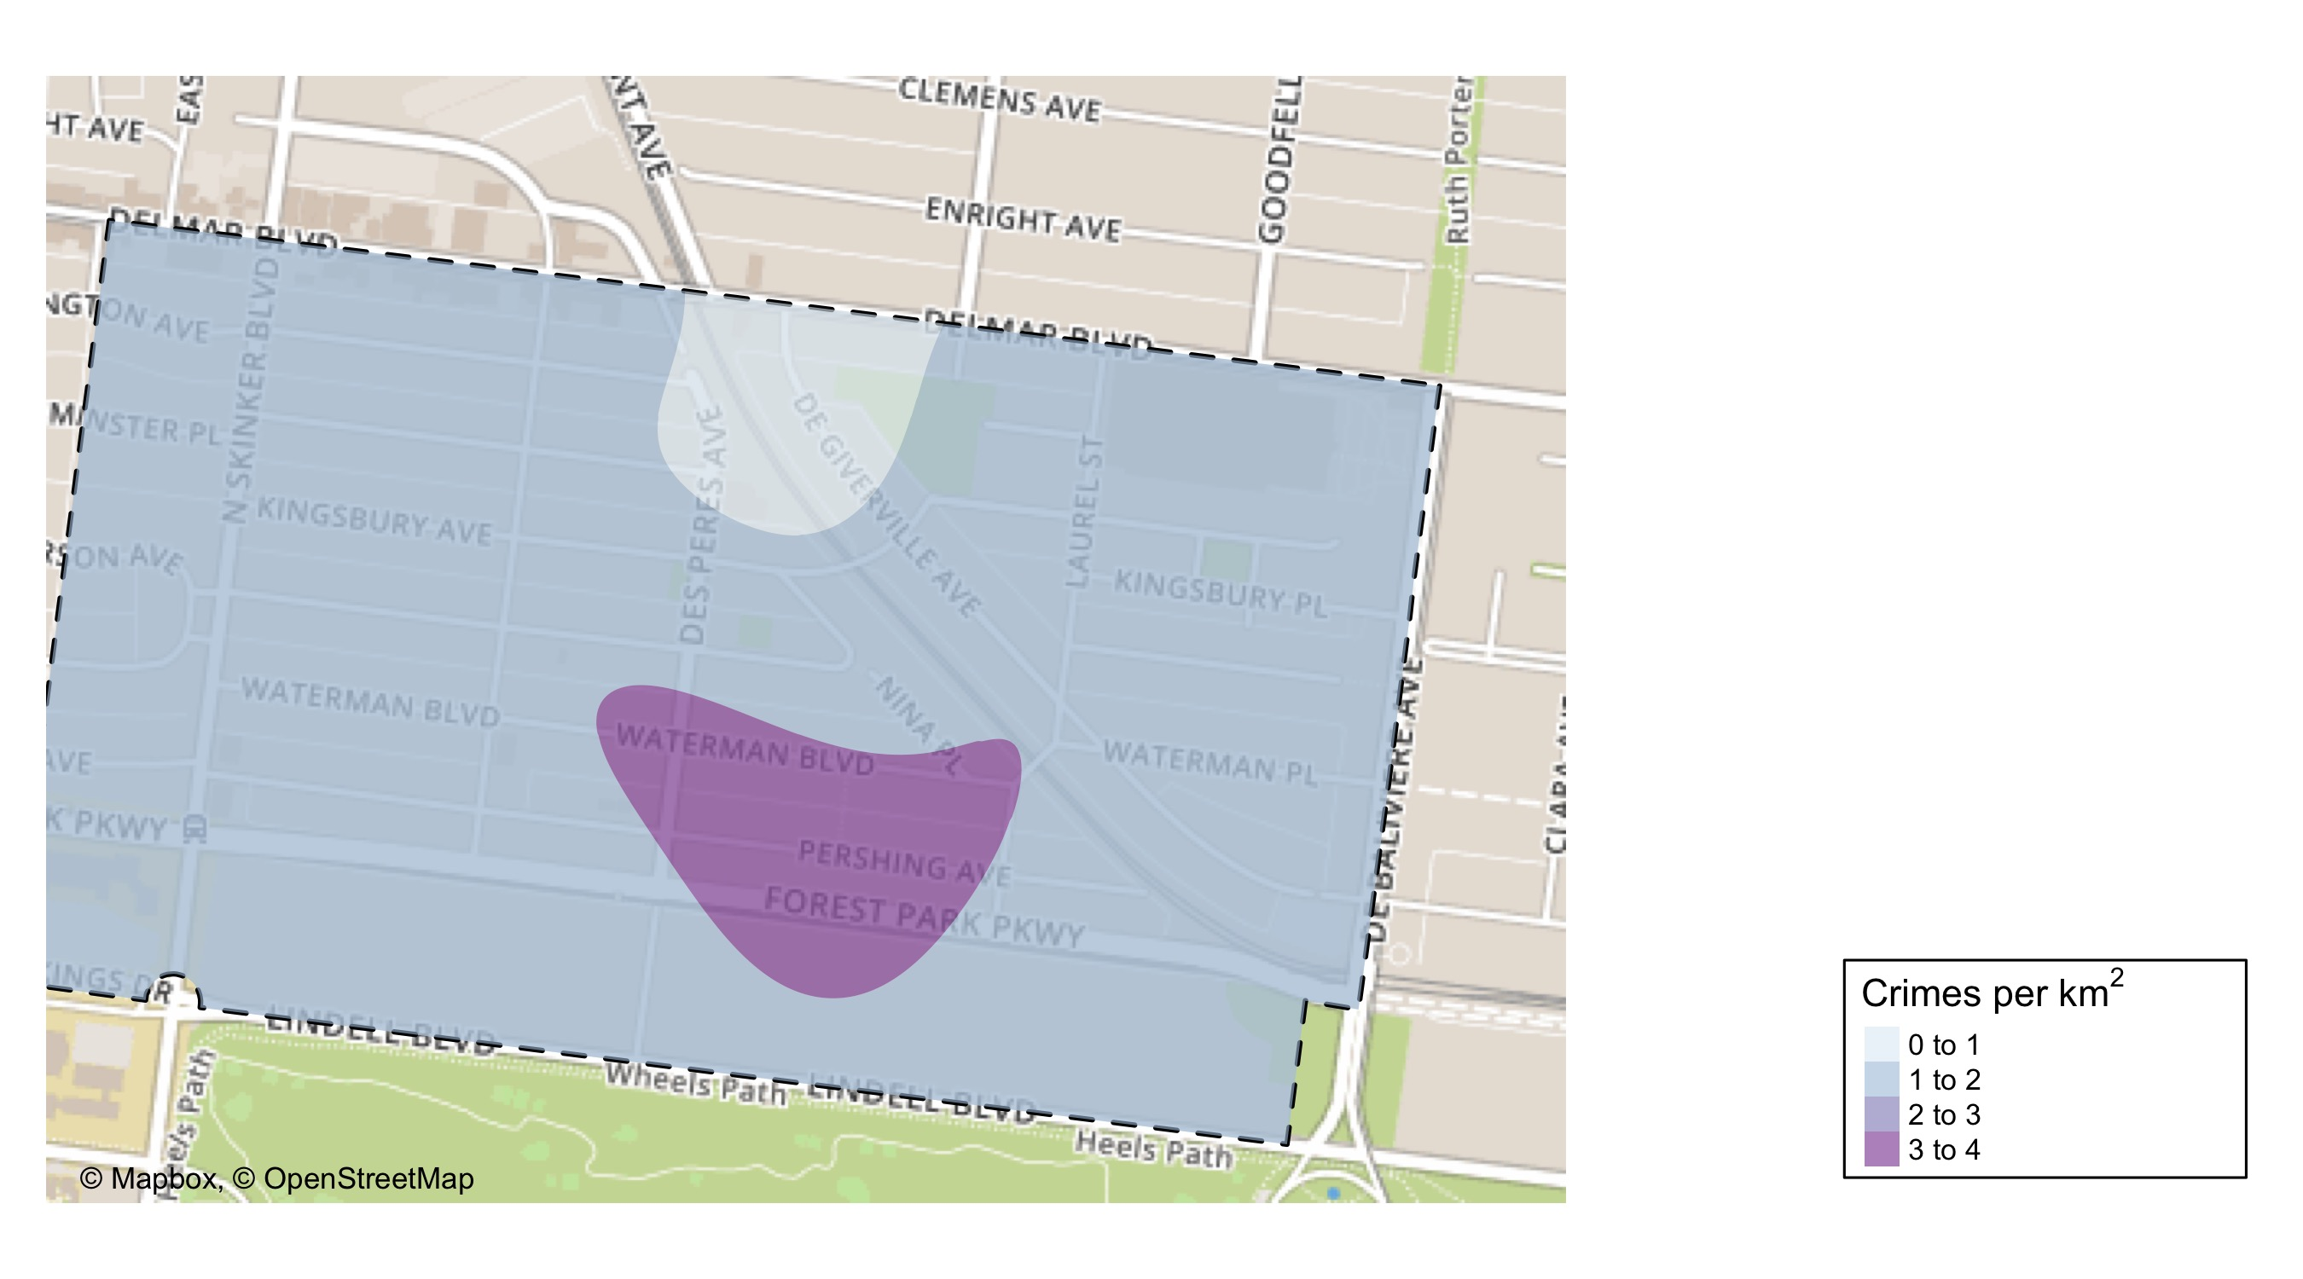
Skinker DeBaliviere: Crime Density Map

Slide 24
Skinker DeBaliviere: Larceny Breakdown
Day of the Week | Number of Crimes
Sun | 3
Wed | 1
Sat | 1
Total | 5
Type of Larceny | Number of Crimes
From Motor Vehicle | 4
Motor Vehicle Parts | 1
Total | 5
Time of Day | Number of Crimes
Day | 5
Total | 5
Monetary | Number of Crimes
$500 - $24,999 | 2
Under $500 | 3
Total | 5

Slide 25
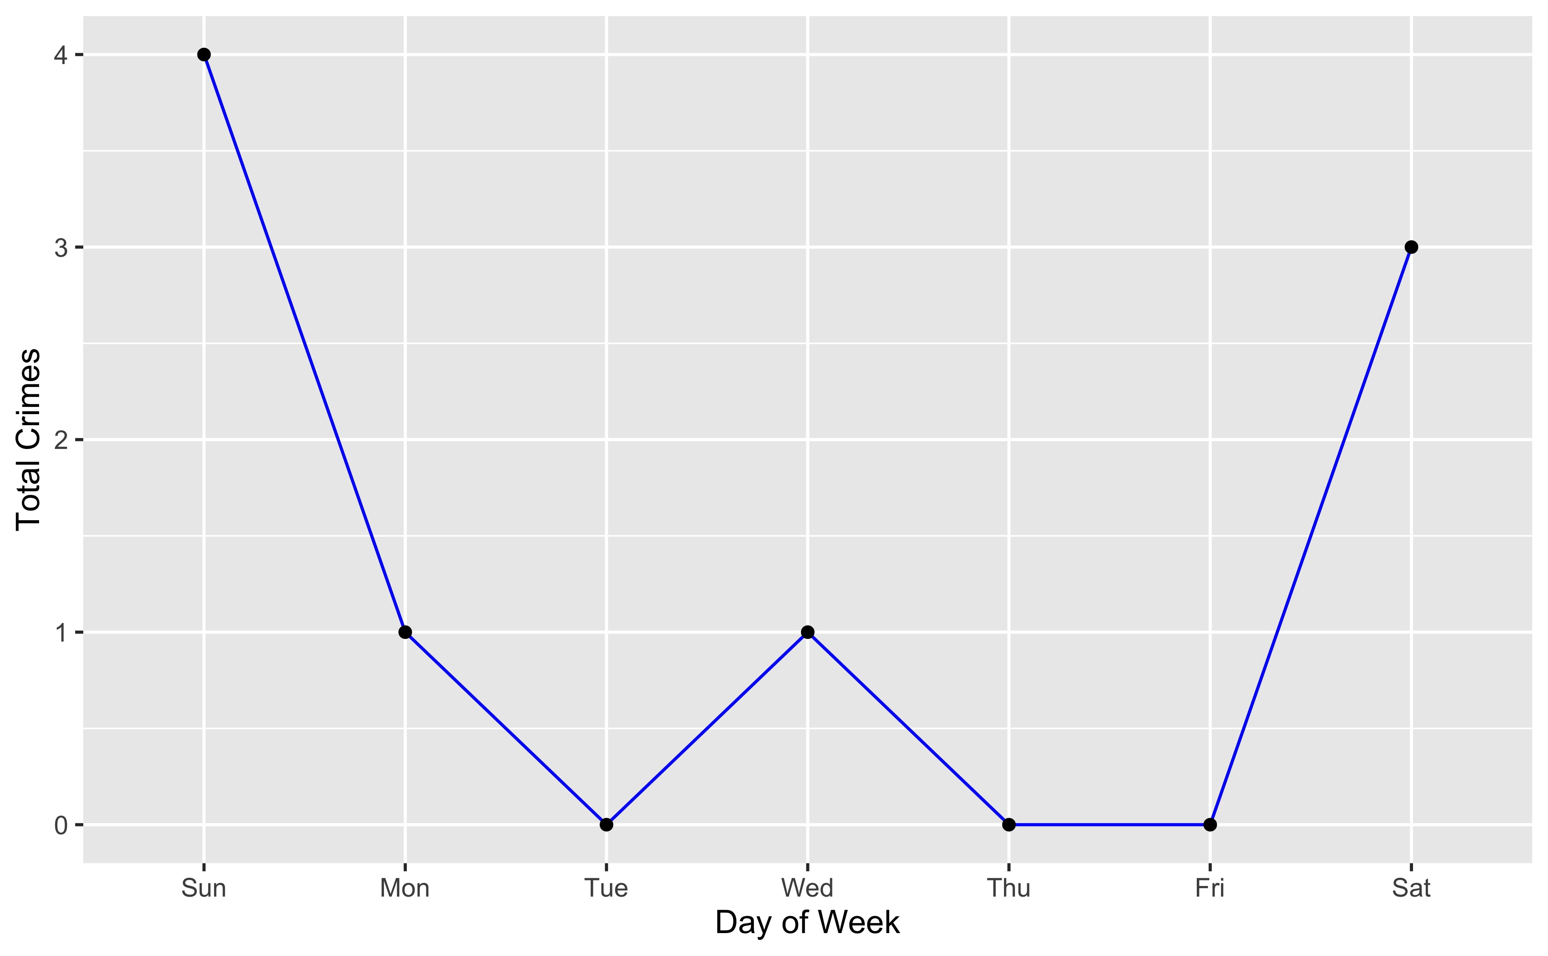
Skinker DeBaliviere: Total Crimes by Days of the Week

Slide 26
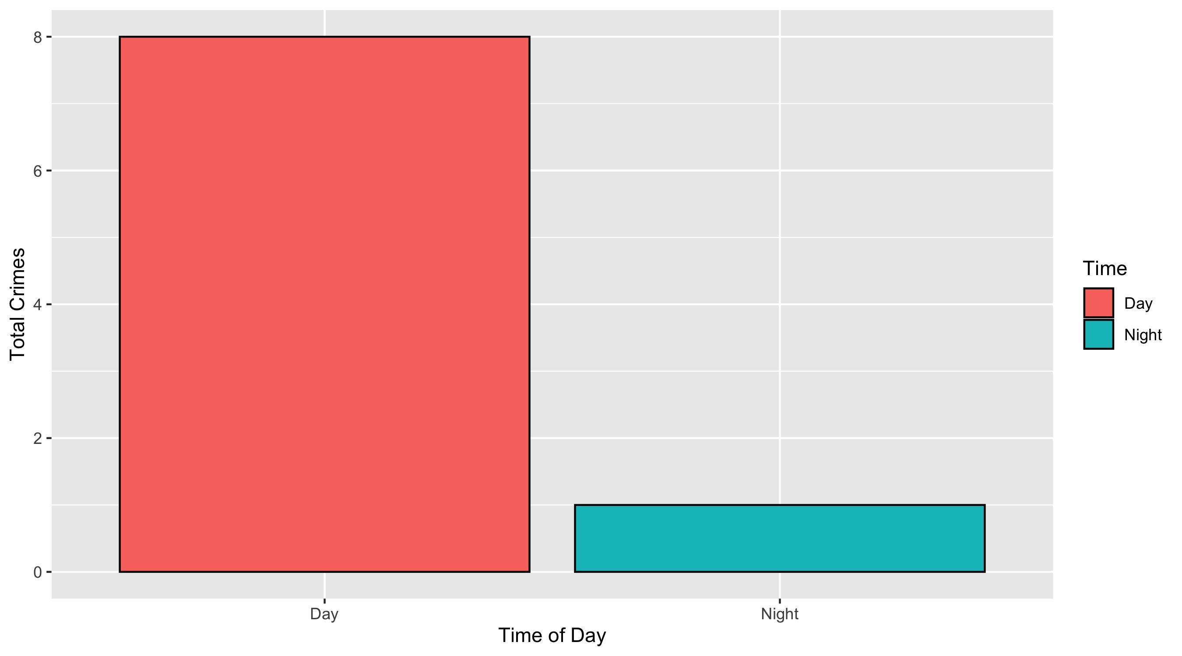
Skinker DeBaliviere: Crimes by Time of Day

Slide 27
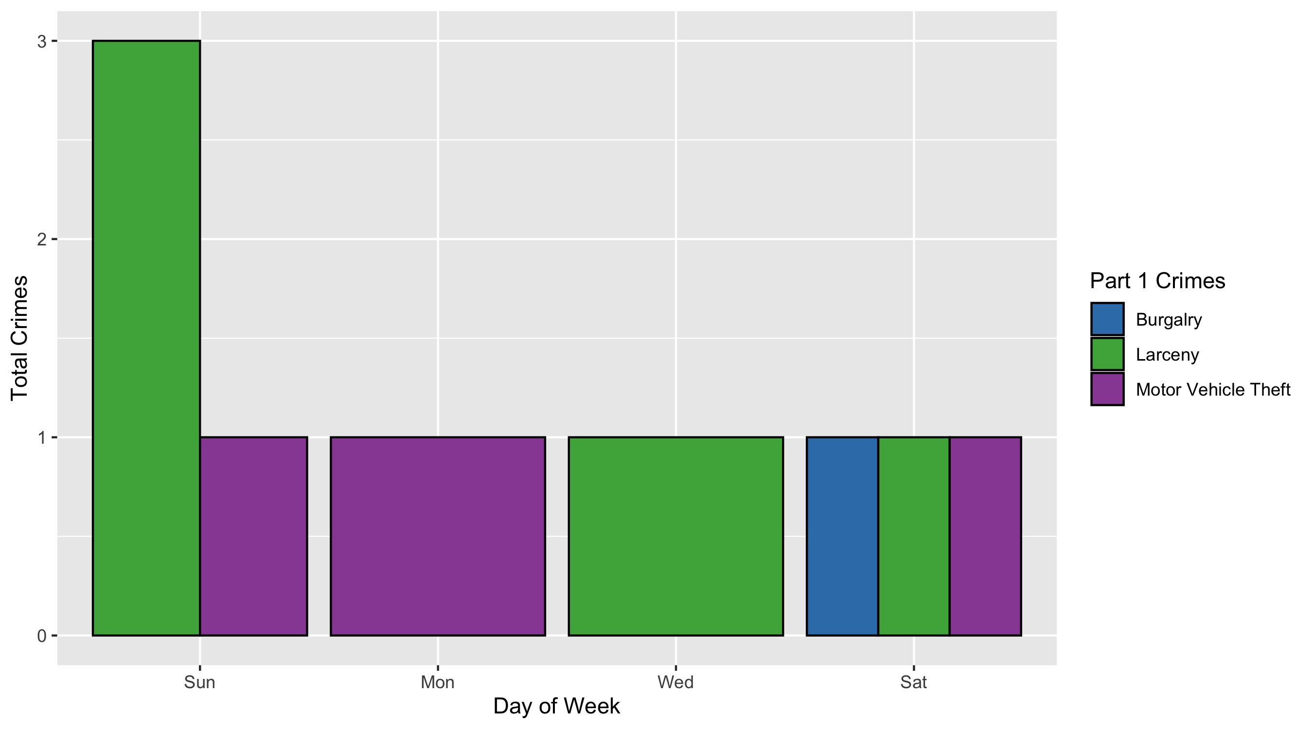
Skinker DeBaliviere: Crimes by Day & Category

Slide 28
DeBaliviere Place: Neighborhood Detail
Appendix 2

Slide 29
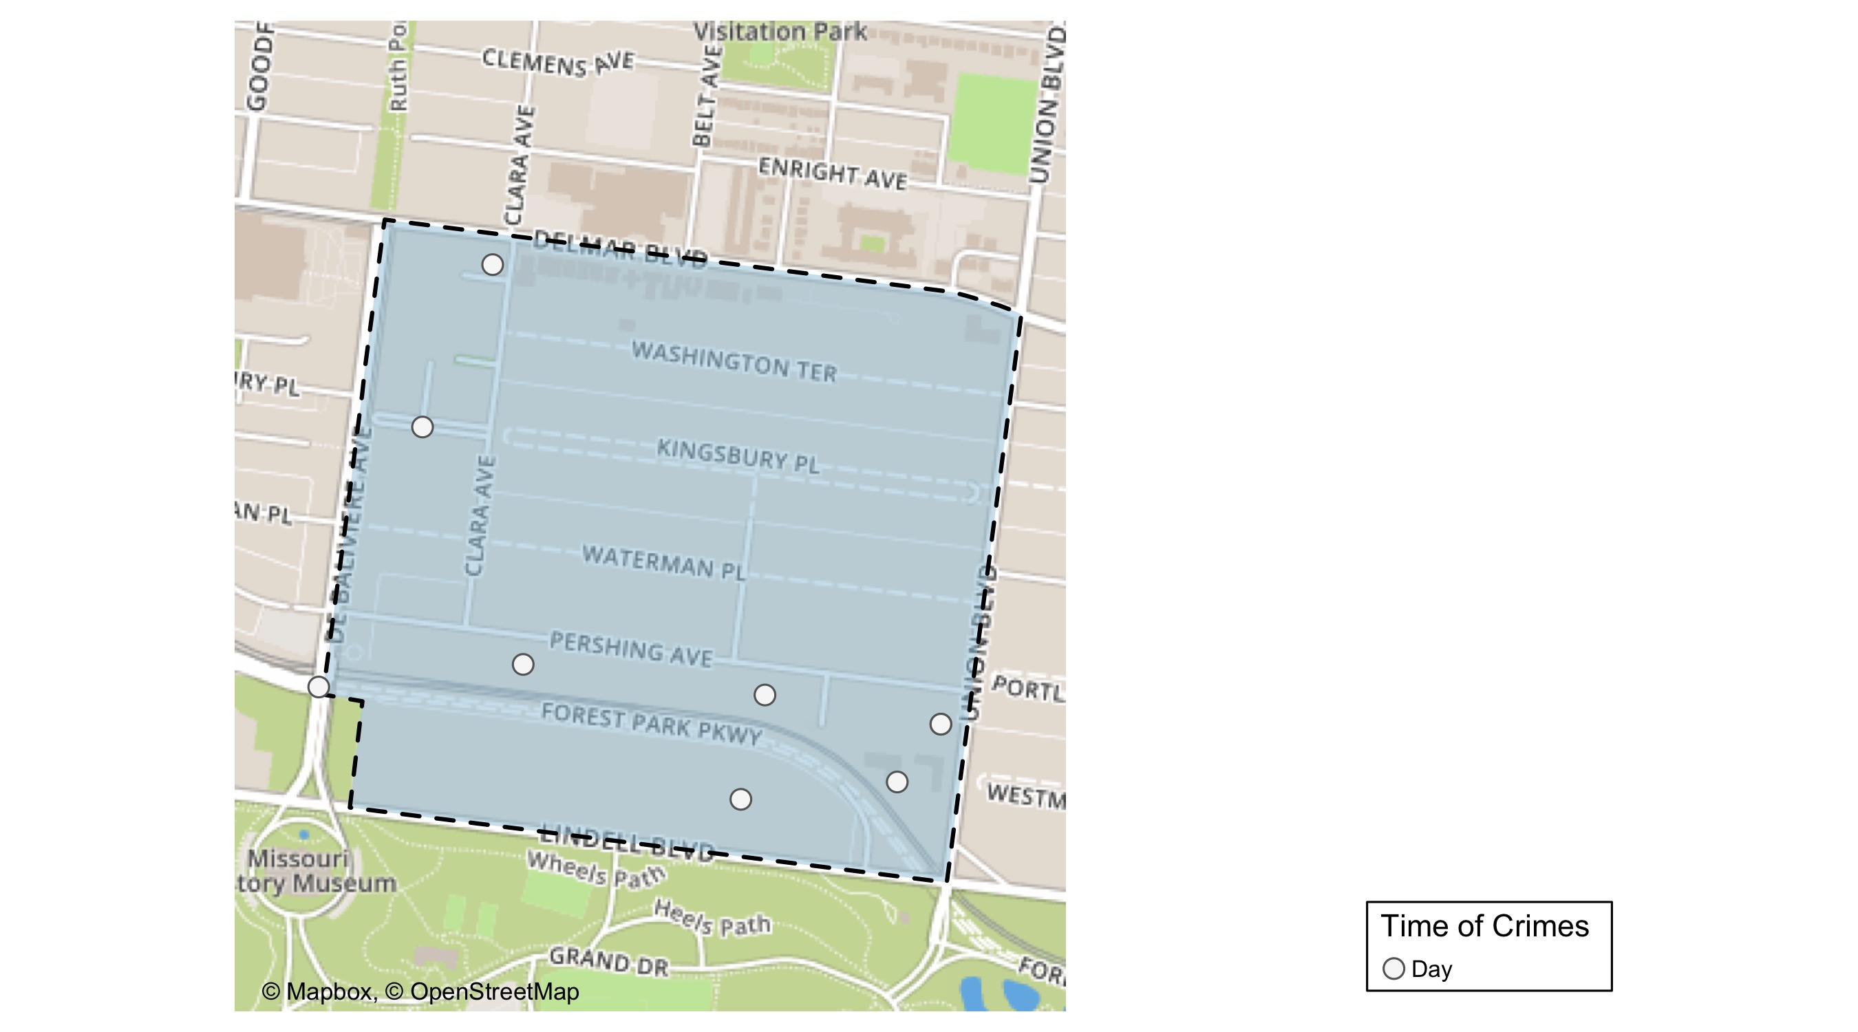
DeBaliviere Place: Time of Crimes map

Slide 30
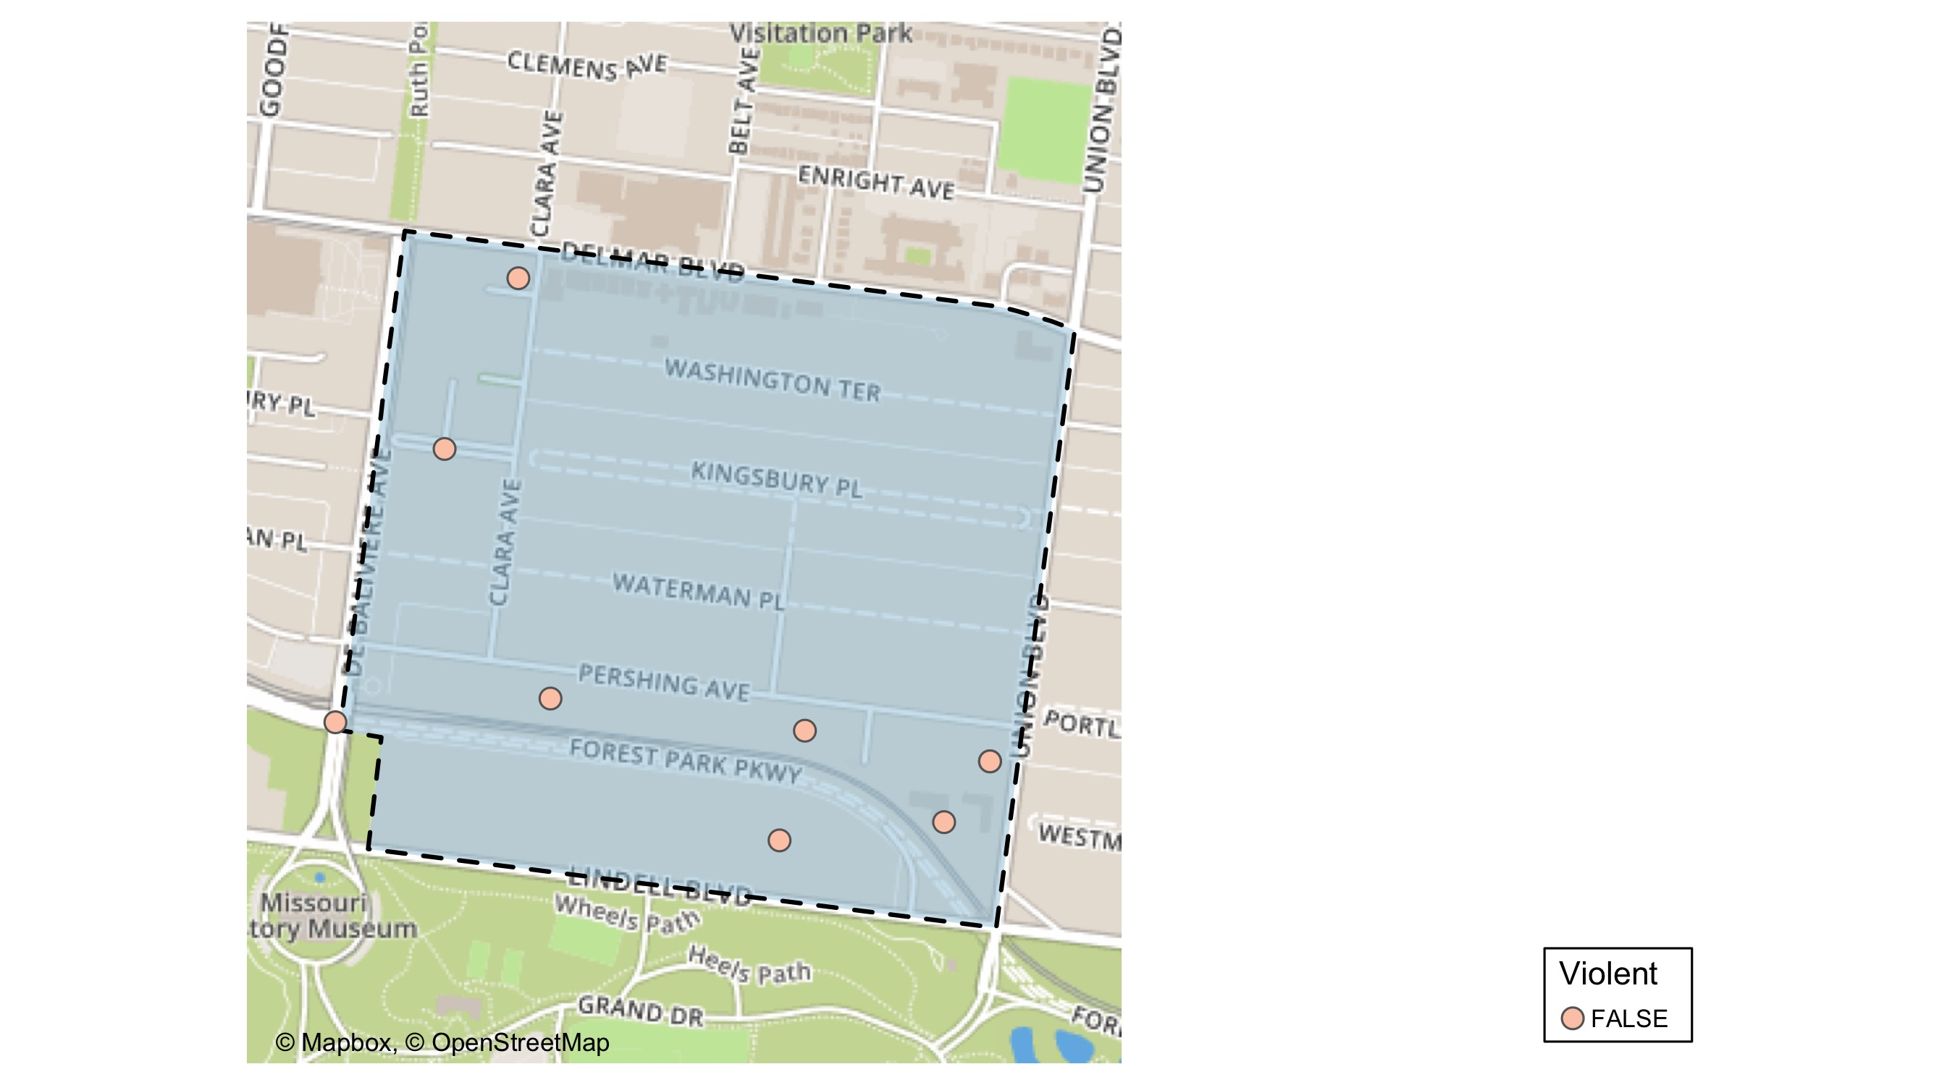
DeBaliviere Place: Violent Crime Map

Slide 31
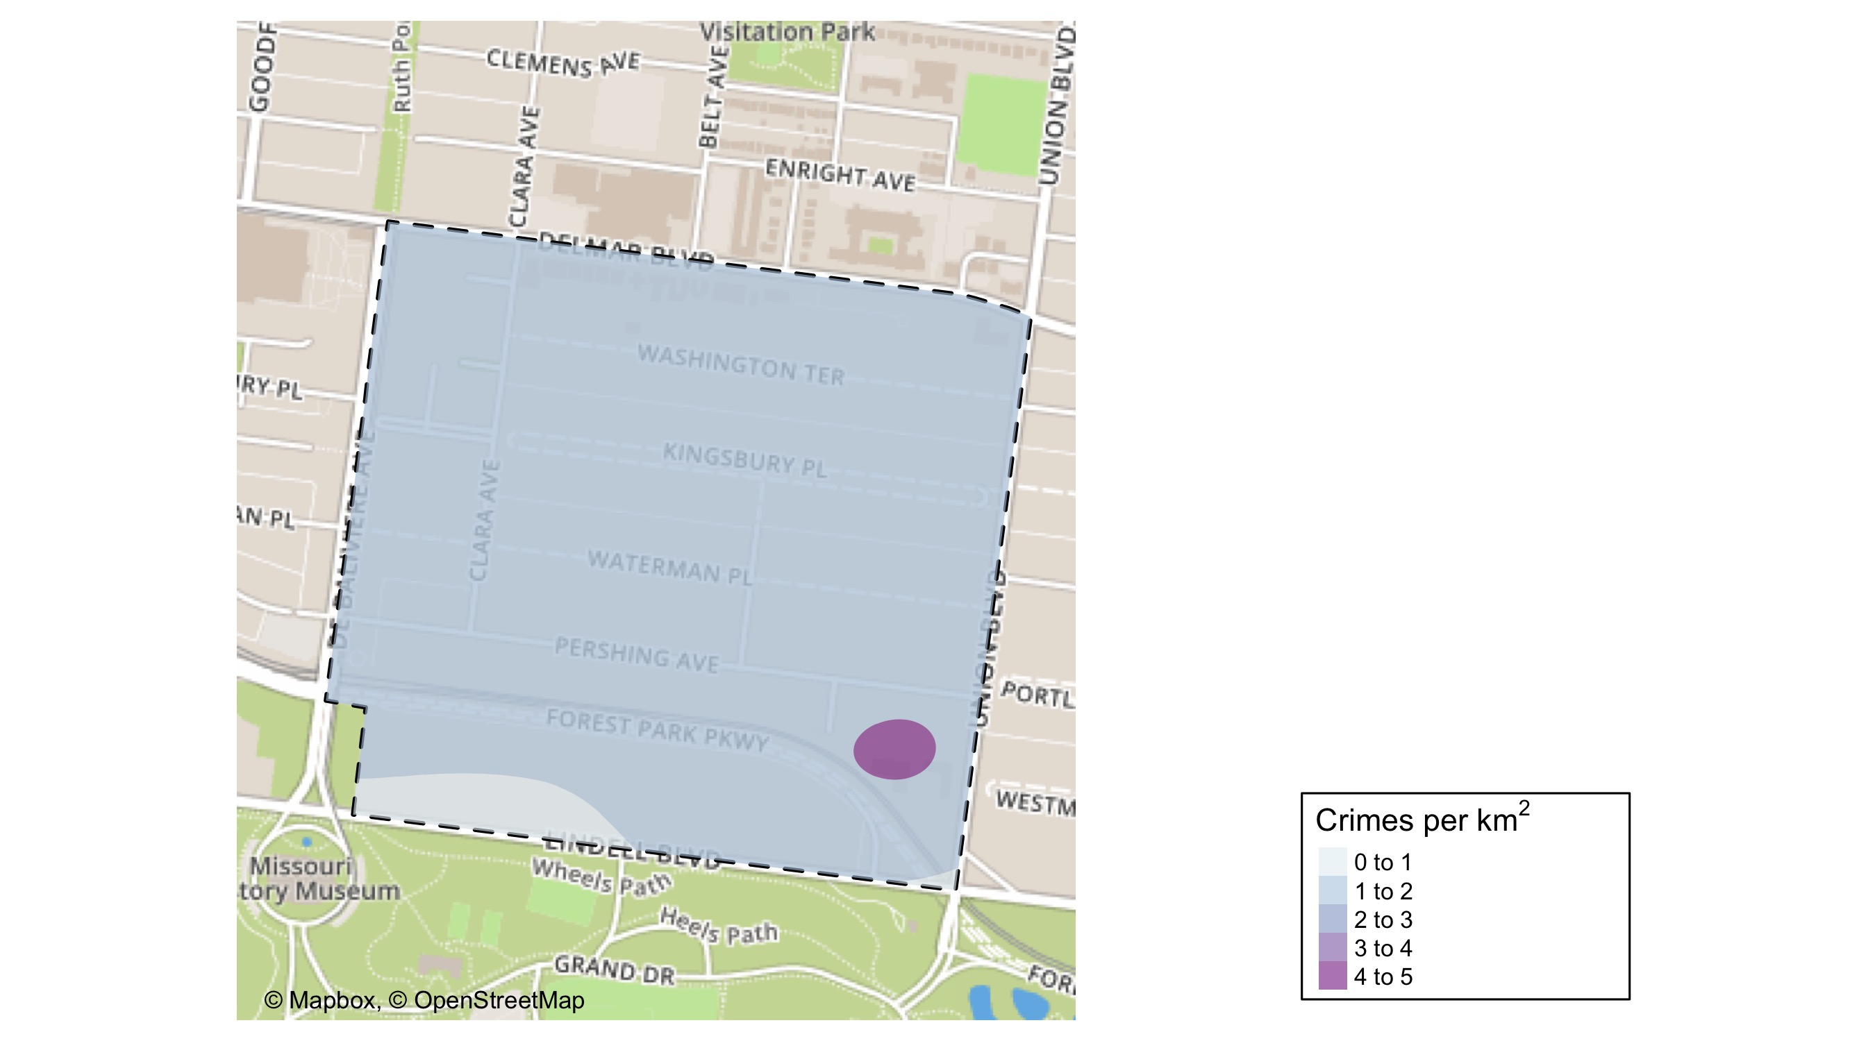
DeBaliviere Place: Crime Density Map

Slide 32
DeBaliviere Place: Larceny Breakdown
Day of the Week | Number of Crimes
Sun | 1
Mon | 1
Tue | 2
Fri | 1
Sat | 1
Total | 6
Type of Larceny | Number of Crimes
All Other | 1
From Motor Vehicle | 3
Motor Vehicle Parts | 2
Total | 6
Time of Day | Number of Crimes
Day | 6
Total | 6
Monetary | Number of Crimes
Under $500 | 6
Total | 6

Slide 33
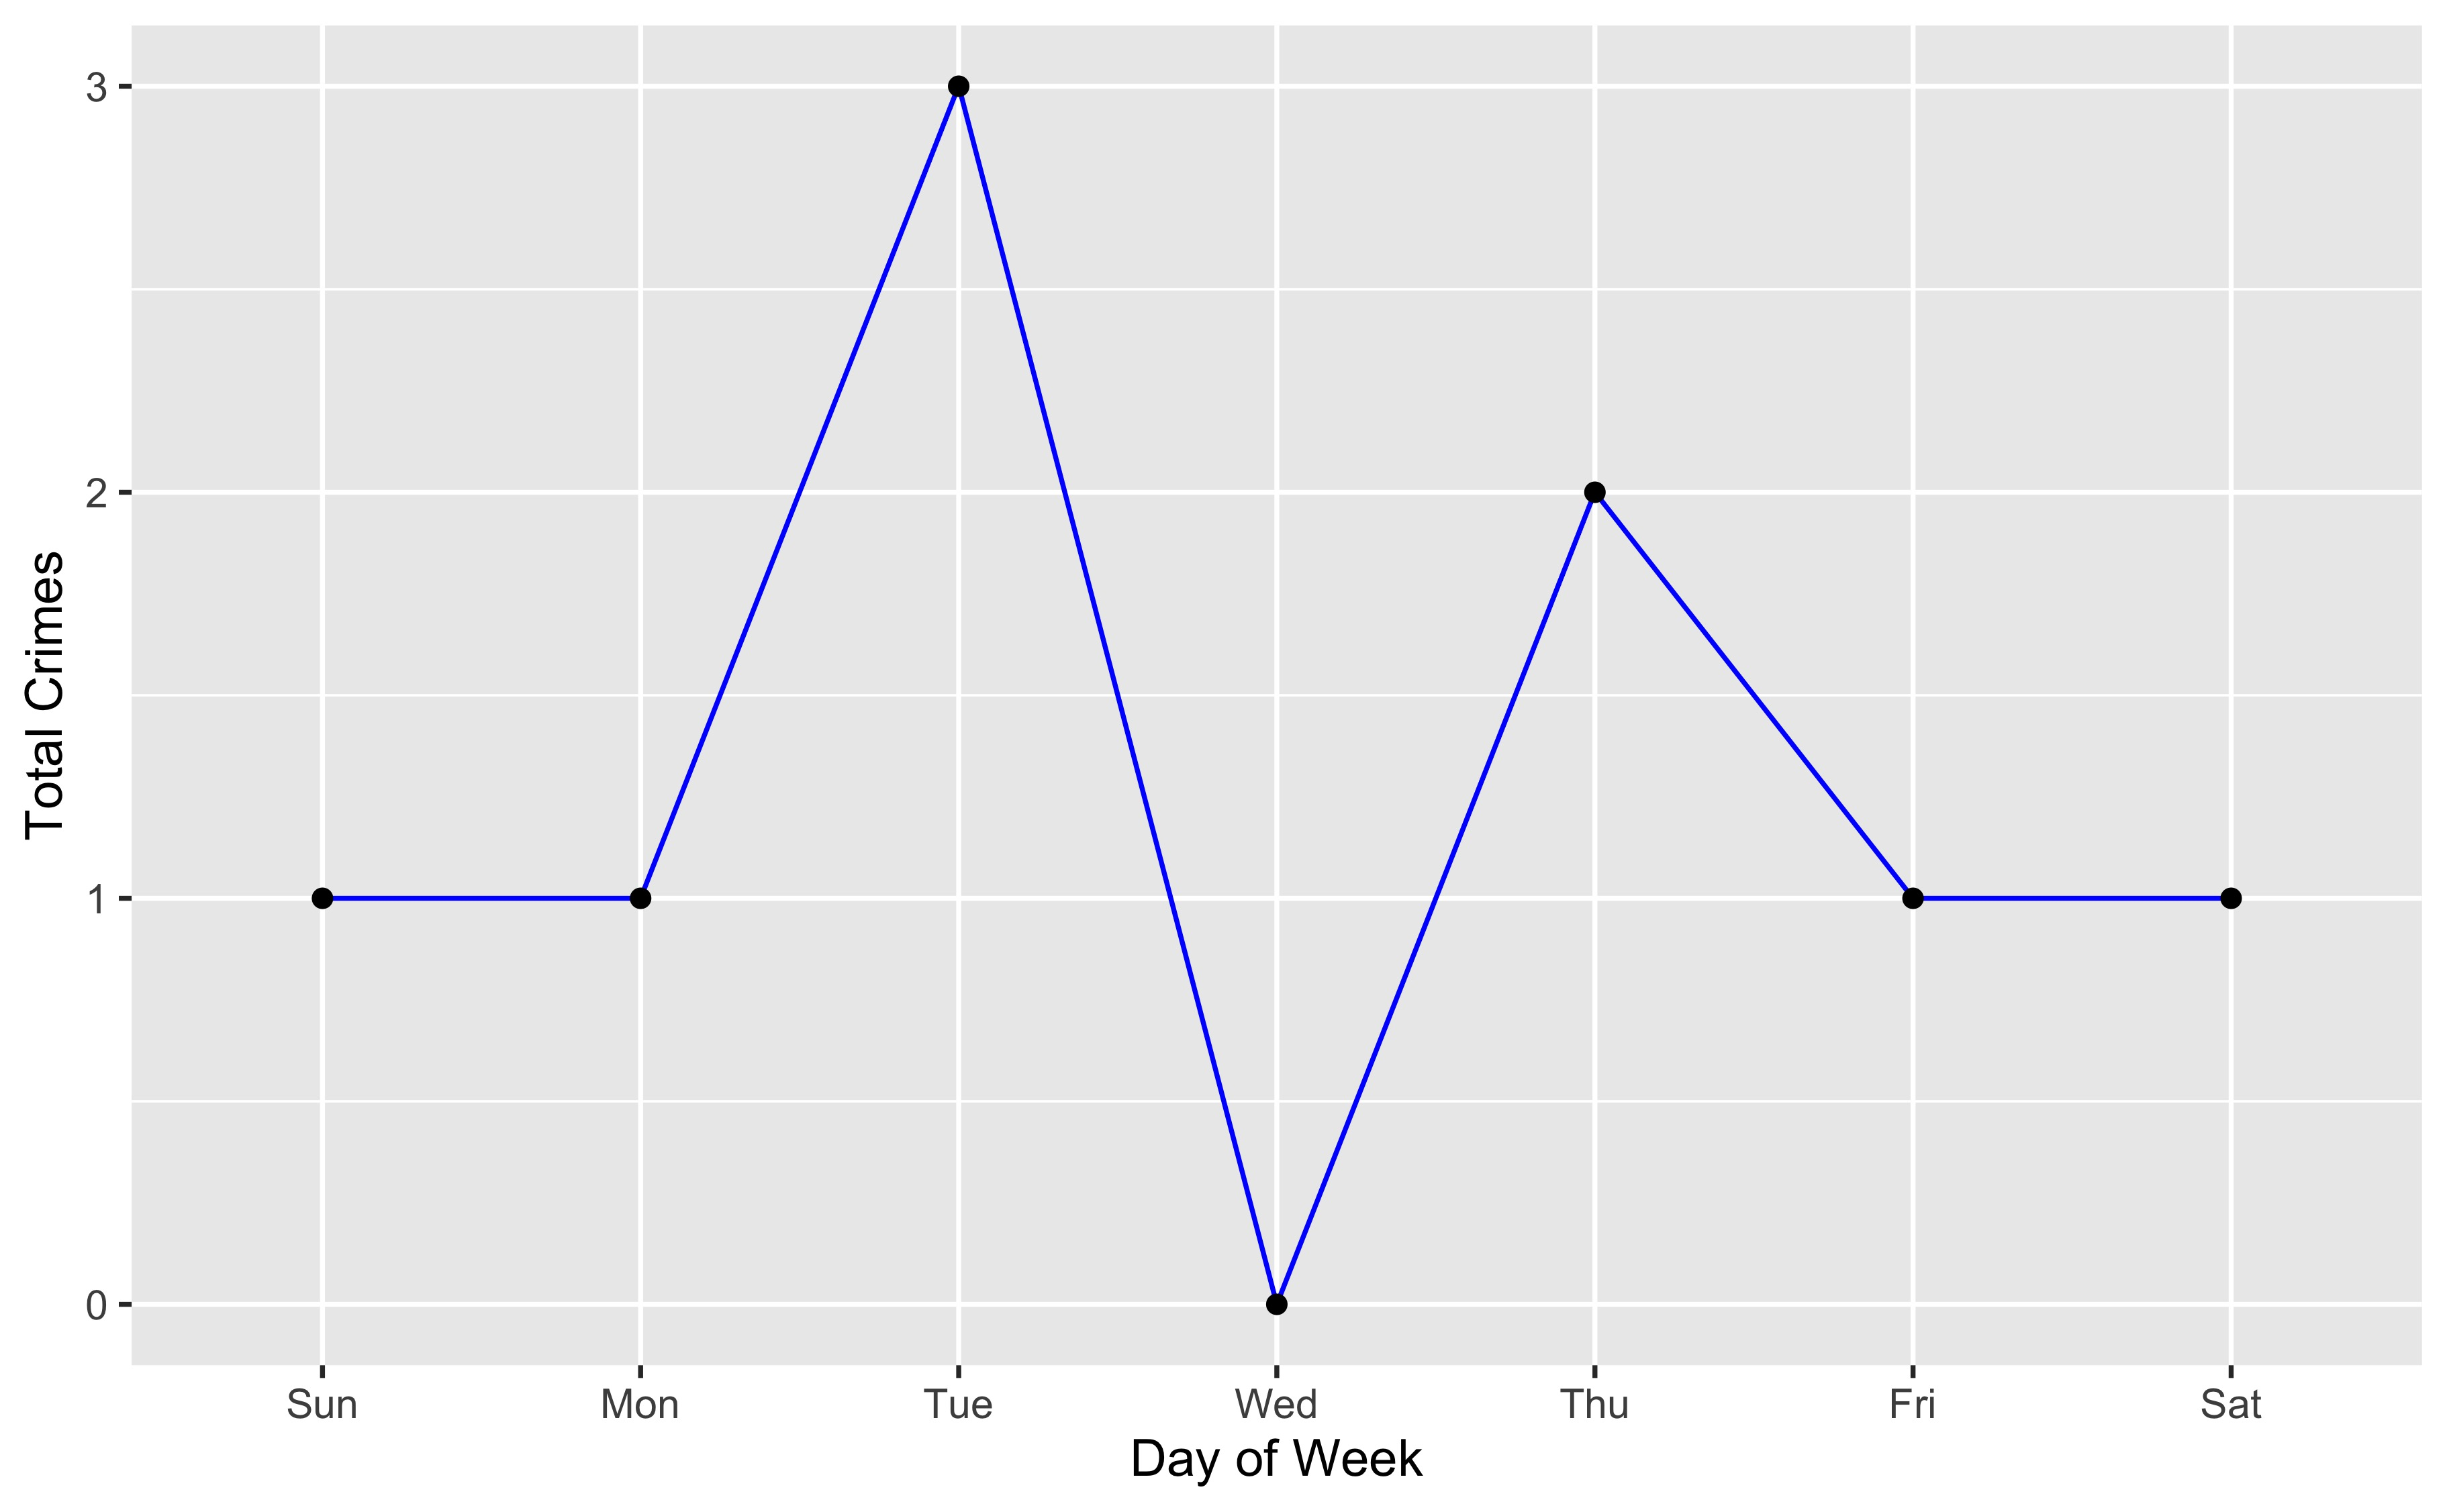
DeBaliviere Place: Total Crimes by Days of the Week

Slide 34
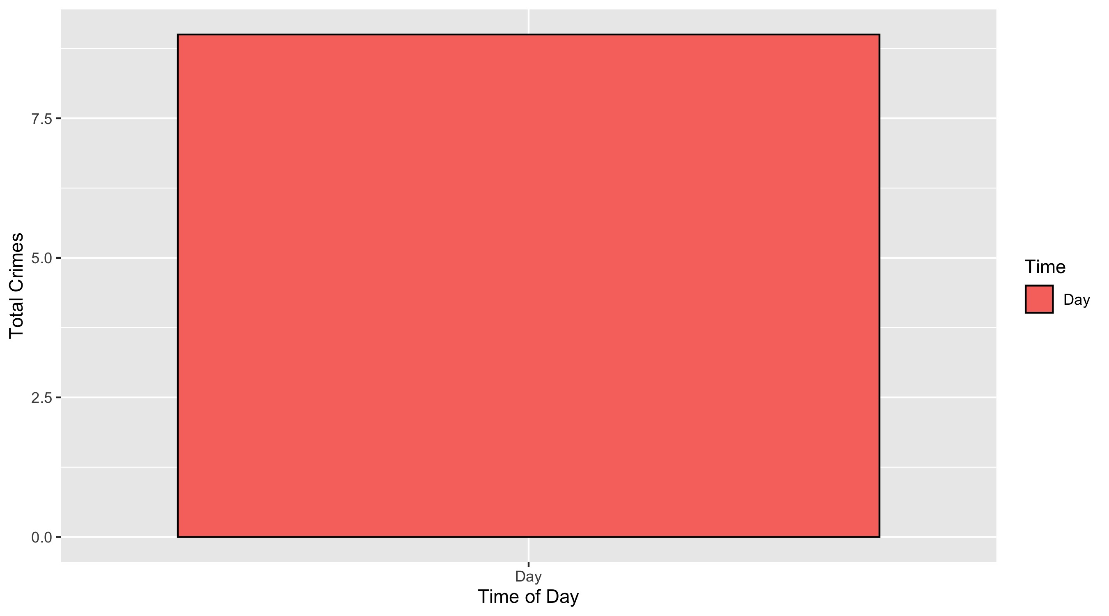
DeBaliviere Place: Crimes by Time of Day

Slide 35
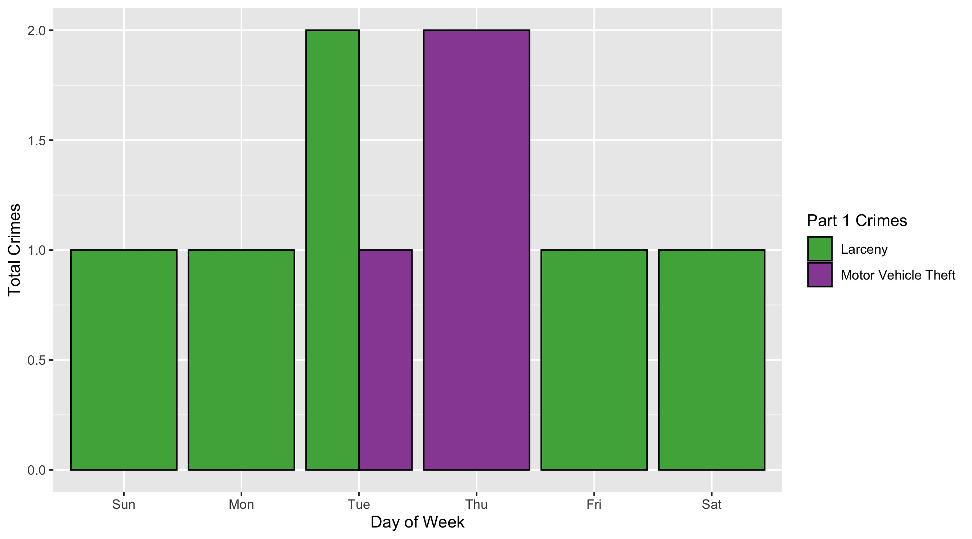
DeBaliviere Place: Crimes by Day & Category

Slide 36
West End: Neighborhood Detail
Appendix 3

Slide 37
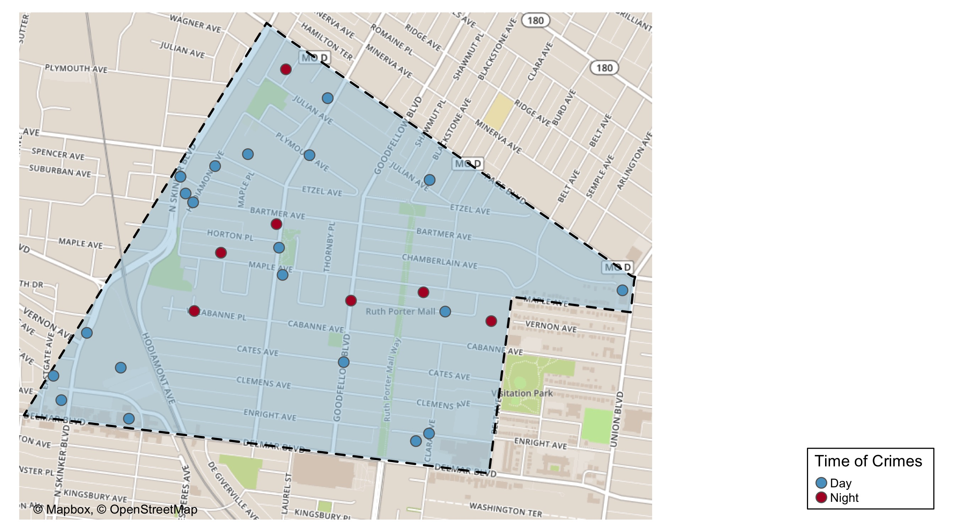
West End: Time of Crimes Map

Slide 38
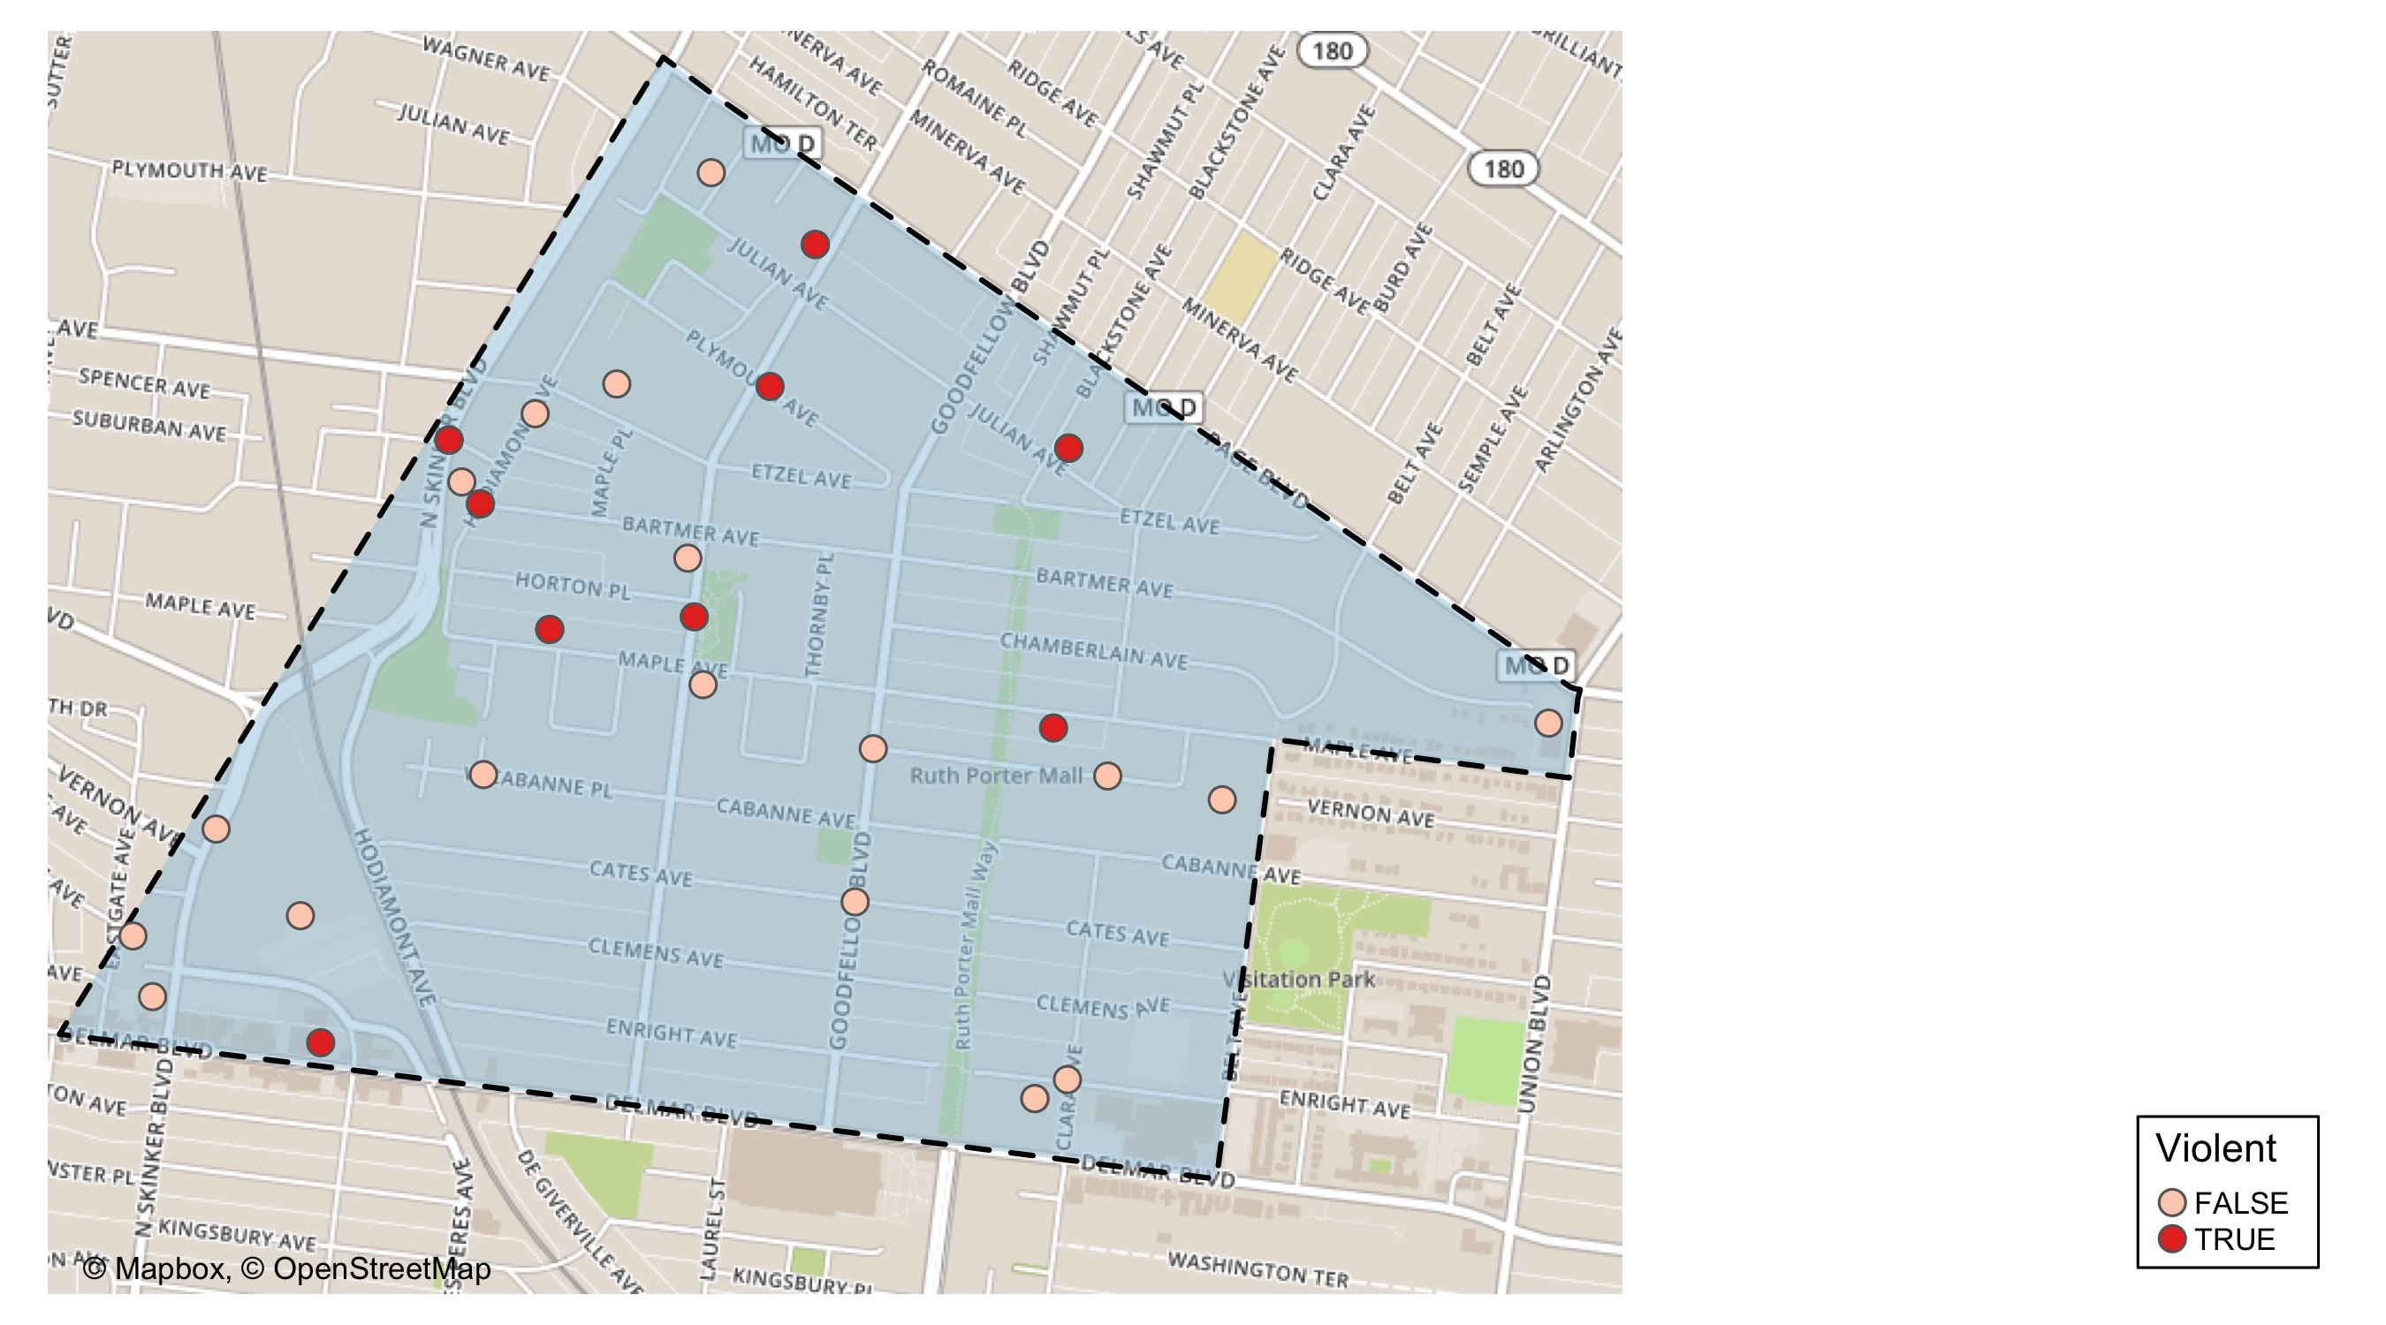
West End: Violent Crime Map

Slide 39
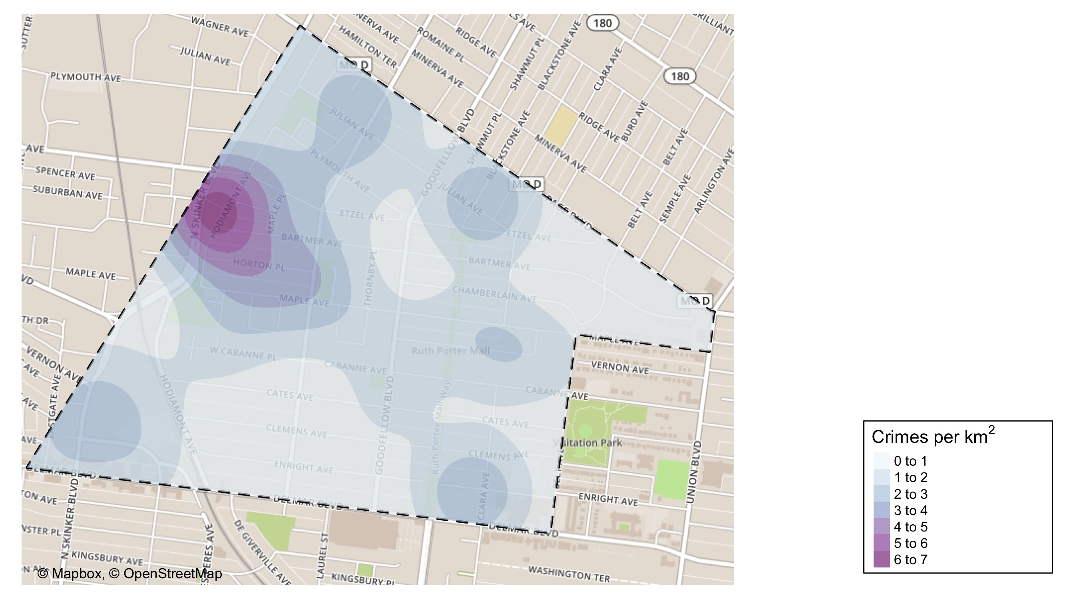
West End: Crime Density

Slide 40
West End: Larceny Breakdown
Day of the Week | Number of Crimes
Mon | 3
Wed | 1
Thu | 1
Fri | 3
Sat | 1
Total | 9
Type of Larceny | Number of Crimes
All Other | 1
From Motor Vehicle | 3
Motor Vehicle Parts | 4
Shoplifting | 1
Total | 9
Time of Day | Number of Crimes
Day | 7
Night | 2
Total | 9
Monetary | Number of Crimes
$500 - $24,999 | 5
Under $500 | 4
Total | 9

Slide 41
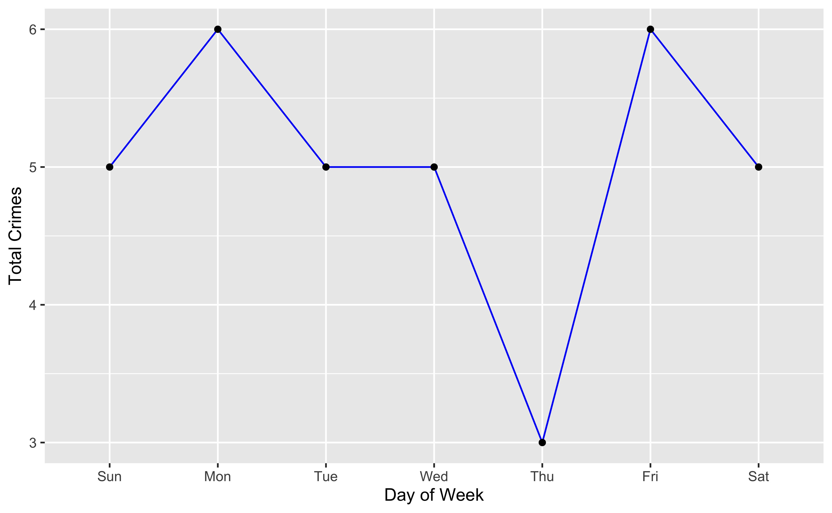
West End: Total Crimes by Days of the Week

Slide 42
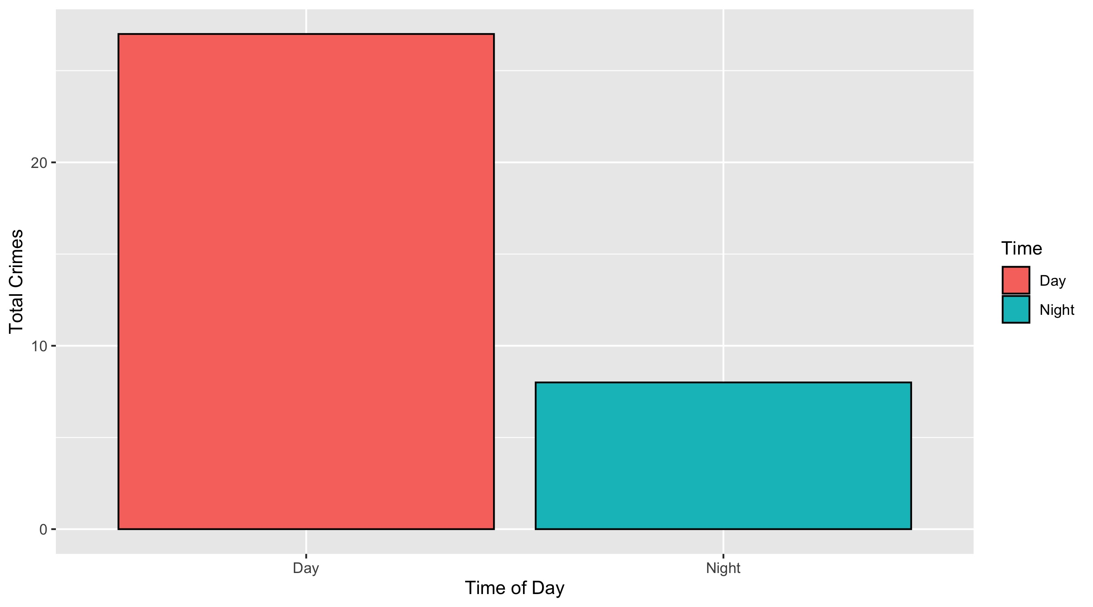
West End: Total Crimes by Days of the Week

Slide 43
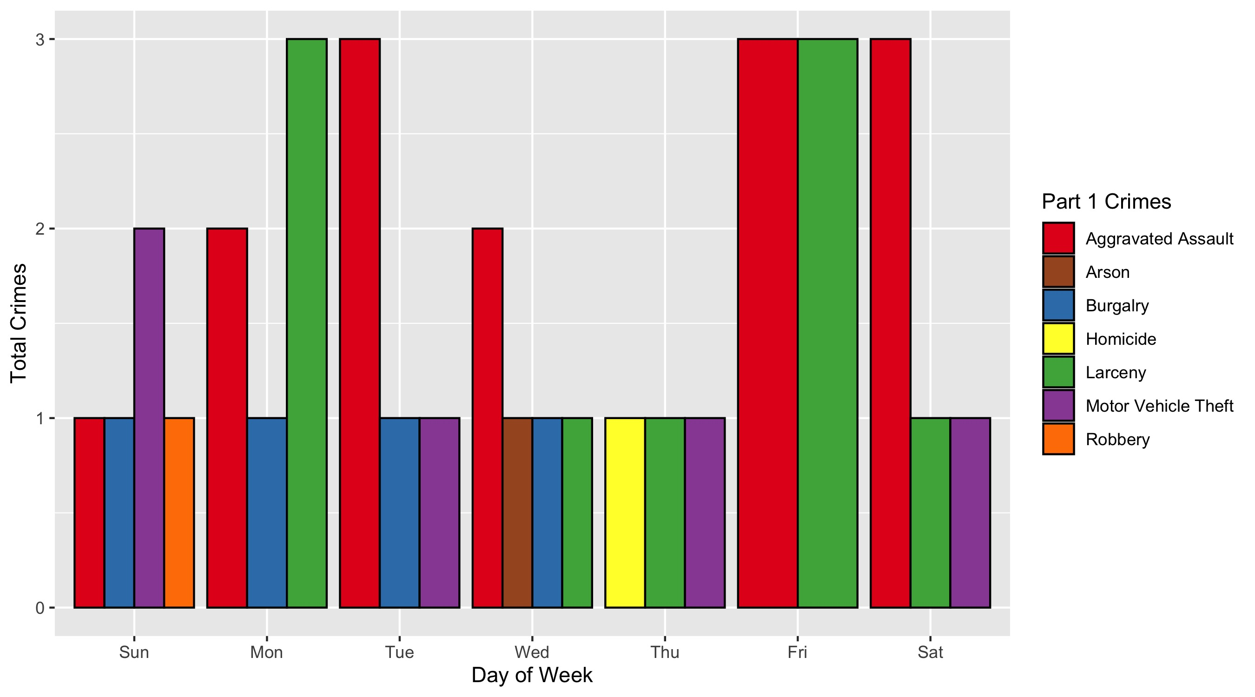
West End: Crimes by Day & Category

Slide 44
Visitation Park: Neighborhood Detail
Appendix 4

Slide 45
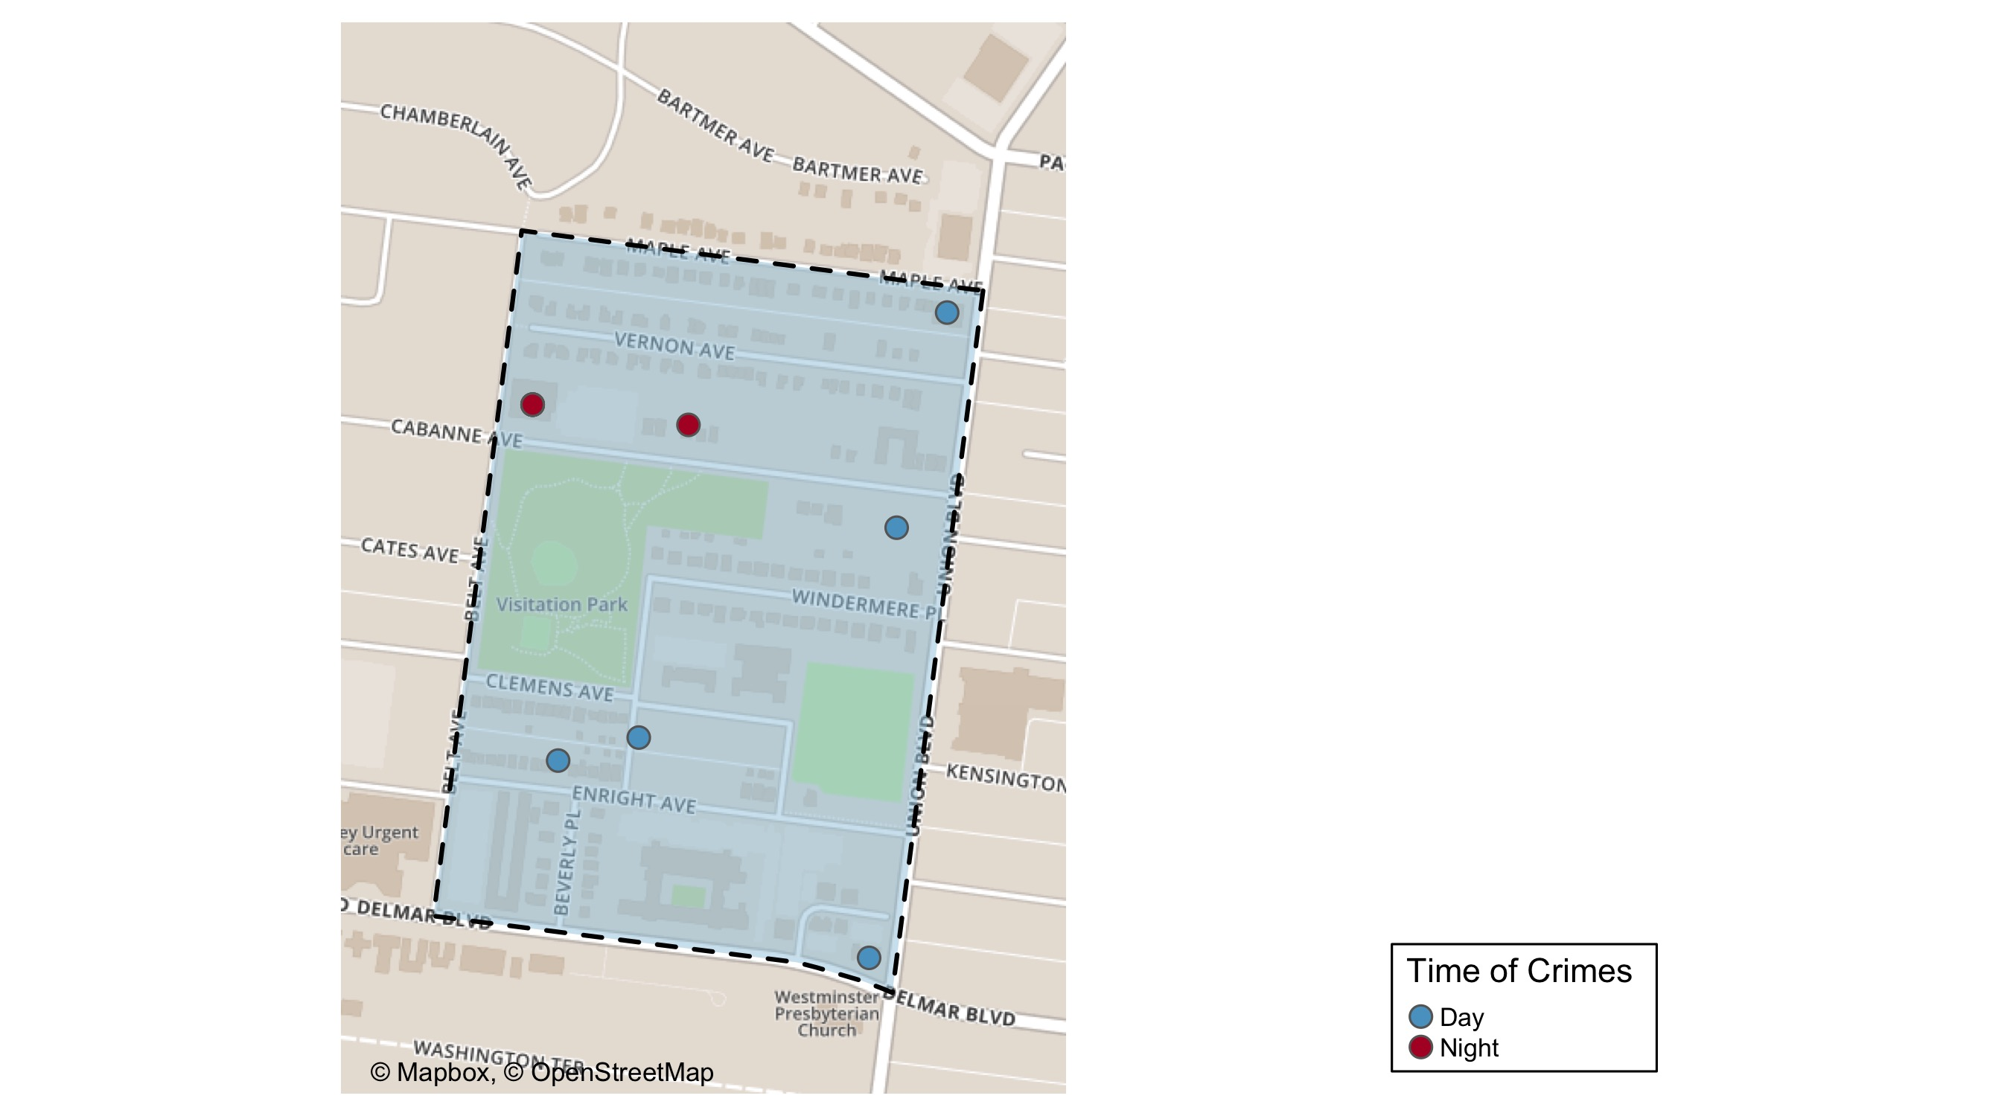
Visitation Park: Time of Crimes Map

Slide 46
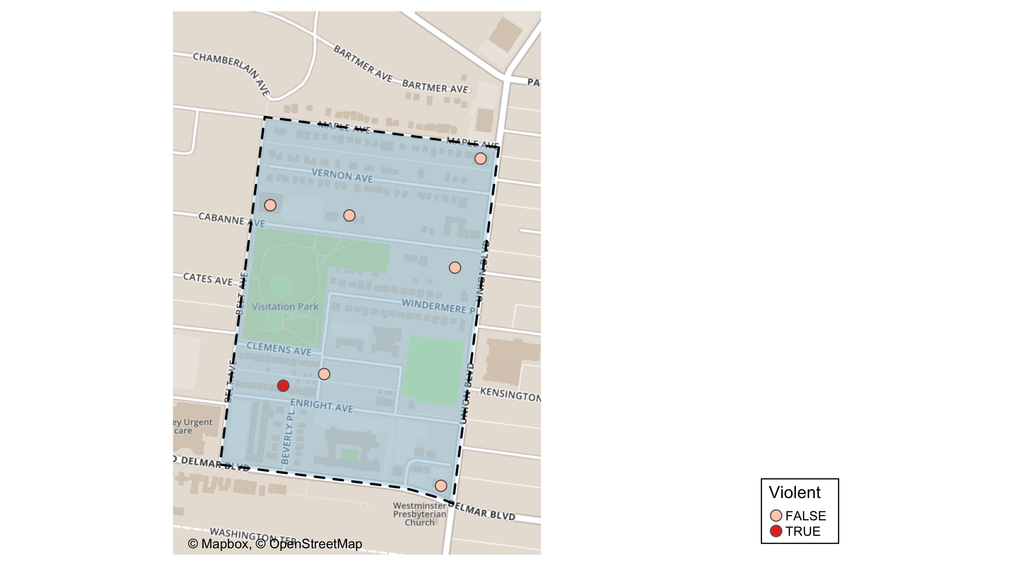
Visitation Park: Time of Crimes Map

Slide 47
Visitation Park: Larceny Breakdown
Day of the Week | Number of Crimes
Sun | 2
Wed | 1
Thu | 1
Fri | 1
Total | 5
Type of Larceny | Number of Crimes
All Other | 1
From Building | 1
From Motor Vehicle | 2
Motor Vehicle Parts | 1
Total | 5
Time of Day | Number of Crimes
Day | 3
Night | 2
Total | 5
Monetary | Number of Crimes
$500 - $24,999 | 1
Under $500 | 4
Total | 5

Slide 48
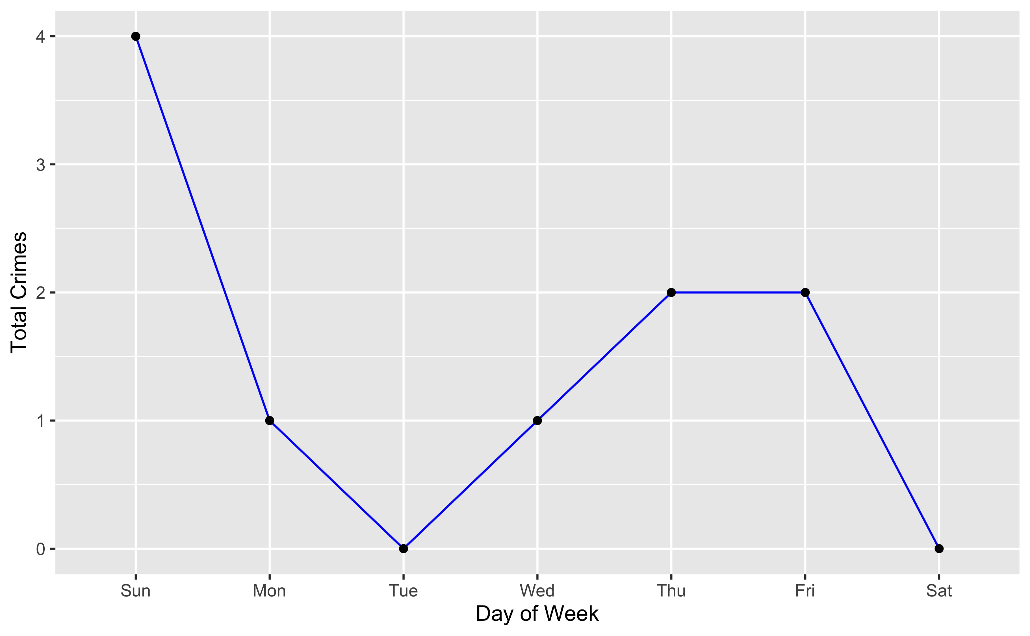
Visitation Park: Total Crimes by Days of the Week

Slide 49
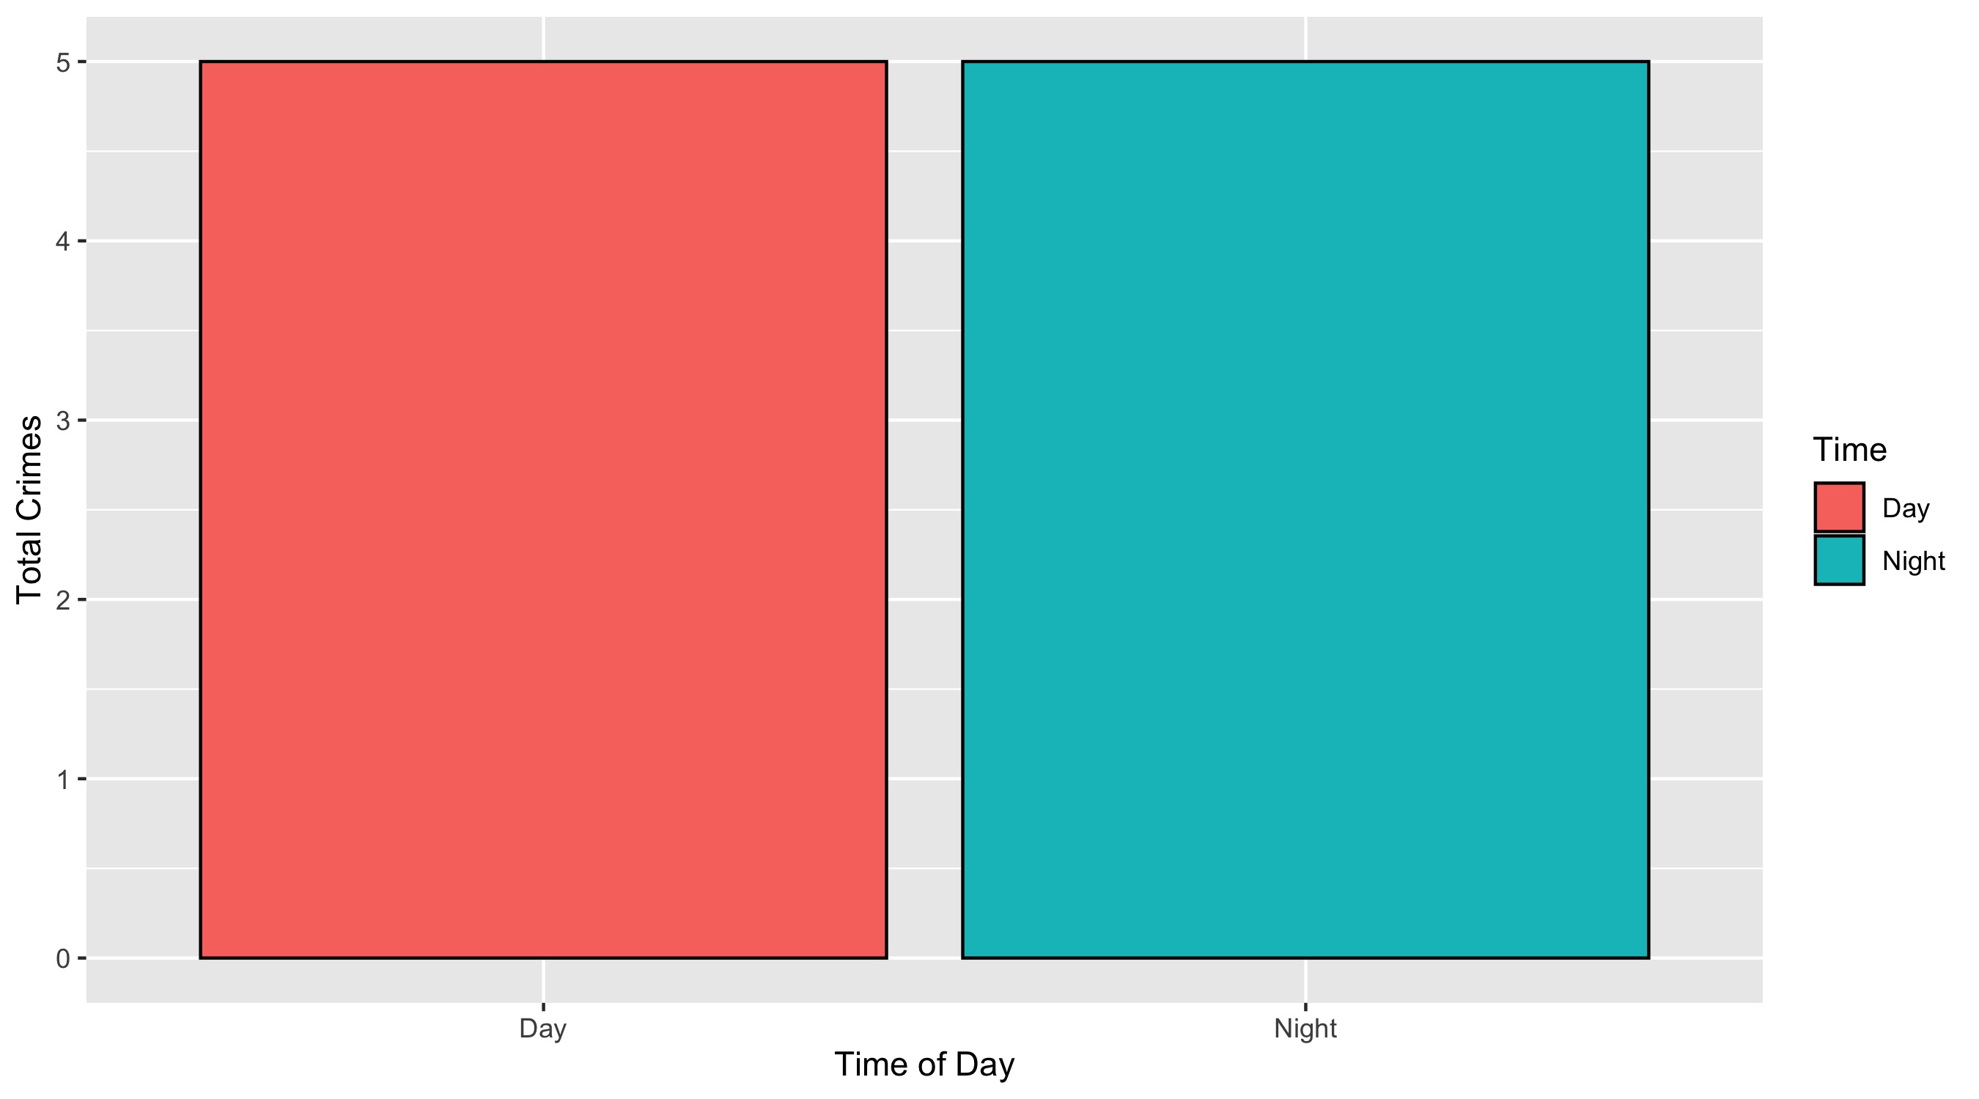
Visitation Park: Crimes by Time of Day

Slide 50
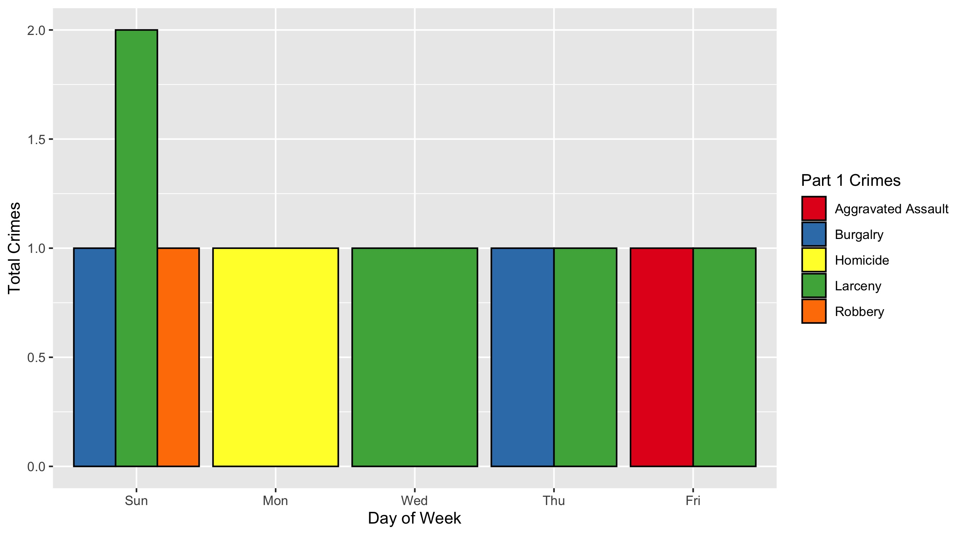
Visitation Park: Crimes by Day & Category

